Slide 1
Ethics of Organ Transplantation

Slide 2
Ethical Considerations in Transplantation
Bruce Gelb, MD FACS
Director of Renal Transplantation
Assistant Professor of Transplant Surgery
Mary Lea Johnson Transplant Center at NYULMC

Slide 3
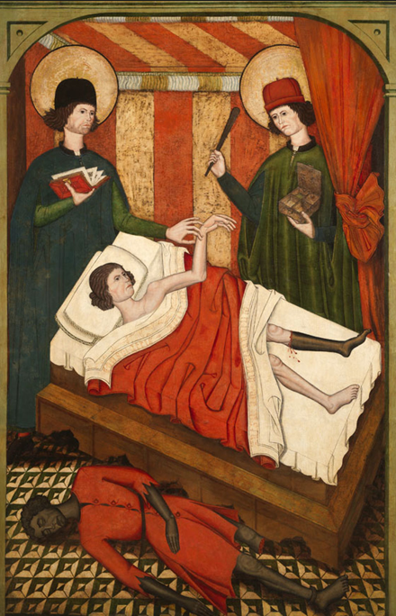
History – ~A.D. 300
School of Castile and Leon, ‘Saints Cosmas and Damian Healing a Christian with the Leg of a Dead Moor’, 1460-1480
Notes:
grafting of a leg from a recently deceased Ethiopian to replace a patient's ulcered or cancerous leg
Twin Brothers in Syria

Slide 4
History - 1936
First Modern Attempt (Allotransplantation)
Russia, 1936 Surgeon: Yurii Voronoy
Cadaveric kidney transplant
Recipient: 26F, mercury poisoning
Donor 60M, trauma.
Kidney functioned for ~ 36 hours
Recipient died 2 days after surgery

Slide 5
History - 1950
First U.S. Attempt (kidney)
Cadaveric kidney transplant
Recipient: 44F, PCKD
Donor COD: liver failure.
Graft function for 10 months
Recipient lived another 5 years

Slide 6
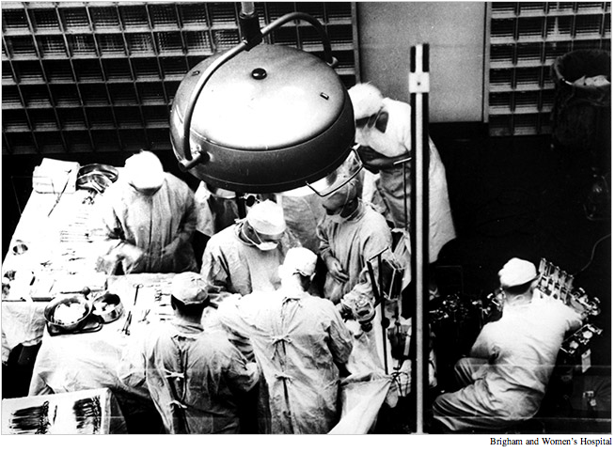
History - December 23, 1954

Slide 7
History
Joseph Edward Murray
(April 1, 1919 – November 26, 2012)
Notes:
An American plastic surgeon

Slide 8
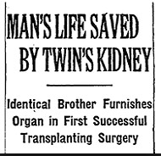
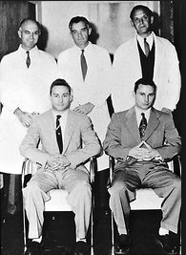
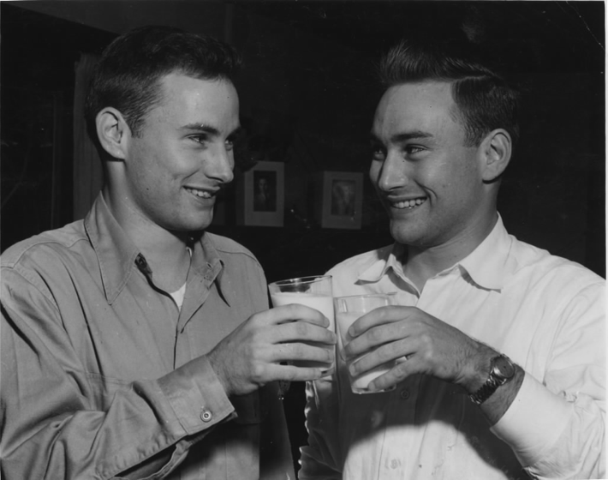
Richard Herrick – ESRD secondary to chronic glomerulonephritis
Ronald Herrick – Donor (Died Age 79)
Recipient lived for 9 years after transplant (kidney functioned until the time of death)
Notes:
These are the donor and recipient, Ronald and Richard Herrick, who were identical twins. This obviated the requirement for immunosuppression.

Slide 9
1931-2010
Richard Herrick – ESRD secondary to chronic glomerulonephritis
Ronald Herrick – Donor (Died Age 79)
Patient Survival: 9 years (Myocardial Infarction)
Graft Survival: 9 years
Notes:
These are the donor and recipient, Ronald and Richard Herrick, who were identical twins. This obviated the requirement for immunosuppression.

Slide 10
Were these surgeries ethical???

Slide 11
Is the concept of Ethics new?
Medical ethics have been present since Antiquity!
Hippocratic Oath
Formula Comitis Archiatrorum – 5th Century
Conduct of a Physician - Ishaq ibn Ali al-Ruhawi
Maimonides - Jewish
Thomas Aquinas – Roman Catholic

Slide 12
Bioethics
Biology (Science) and Medicine
Current Topics:
Abortion
Euthanasia
Surrogacy
Scarce Resources
Organ Donation and Allocation
Rare Drugs/New therapies

Slide 14
Ethics - Framework
Autonomy
Beneficence
Non-Maleficence
Justice
Respect
Truthfulness/Honesty

Slide 15
Finding Balance
Individual Population

Slide 16
Ethics - Framework
Autonomy
When does a patient have the right to make a decision, even if it seams wrong?
Recipient
Donor
Beneficence
Non-Maleficence
Justice
Respect
Truthfulness/Honesty

Slide 17
Ethics - Framework
Autonomy
Beneficence
Actions that benefit the well-being of others
Who deserves more benefit?
Non-Maleficence
Justice
Respect
Truthfulness/Honesty

Slide 18
Ethics - Framework
Autonomy
Beneficence
Non-Maleficence
“The treatment was a success, but the patient died”
Risk / Benefit analysis
Justice
Respect
Truthfulness/Honesty

Slide 19
Finding Balance The Double Effect
Beneficence Maleficence
Beneficence Autonomy
Often, 1 action will have an effect on 2 ethical considerations
Notes:
Medical gray areas
Conflicting second opinions
Religious or cultural views impact what is considered beneficial and what is harmful

Slide 20
Ethics - Framework
Autonomy
Beneficence
Non-Maleficence
Justice
Equal access to treatment
Respect
Truthfulness/Honesty

Slide 21
Justice/Equality
A MAJOR issue when dealing with a scarce resource
Number of patients >>> available organs
Regional disparity
Waiting time
Organ donor registrations
Comfort with a living donor

Slide 22
Organ Allocation & Distributive Justice
To each person an equal share
To each person according to need
To each person according to effort
To each person according to contribution
To each person according to merit
To each person according to free-market exchanges

Slide 23
Organ Allocation & Distributive Justice
The concept of Maximum Benefit
Medical need
Medical success
How is success defined?
Survival
Raising children
Return to work
Contribution to society
Happiness

Slide 24
Ethical Questions Driven By the Organ Shortage
Should someone who has received one organ transplant be given a second transplant? Or should people who have not had a transplant be given priority over those who have already had one?
Should people whose lifestyle choices (smoking, drinking, drug use, obesity, etc.) damaged their organ be given a chance at an organ transplant?
Should suicidal individuals be given an organ transplant? What if they attempted suicide in the past but are not currently contemplating suicide?

Slide 25
Ethical Questions Driven By the Organ Shortage
Should people who have young children be given an organ transplant over a single person? Over an elderly person? Should age and whether or not a person has children even matter?
Should people who can’t afford expensive anti-rejection drugs be passed over for a transplant? Should people who don’t have insurance and can’t pay for a transplant be allowed to go on the national waiting list?
Should condemned prisoners receive organ transplants? What if they are serving a life sentence without parole?

Slide 26
Ethical Considerations - Donors
Registration Drives: Comission
Opt-out: Ommission
Mandated Choice
Presumed Consent
Incentives
Removing disincentives
At-Risk populations (Prisoners, mentally challenged, victims of abuse, illegal residents)

Slide 27
Ethical Considerations – Living Donors
Obligation
Donor/Recipient disagreement
Relationship
Altruism
Black Market

Slide 28
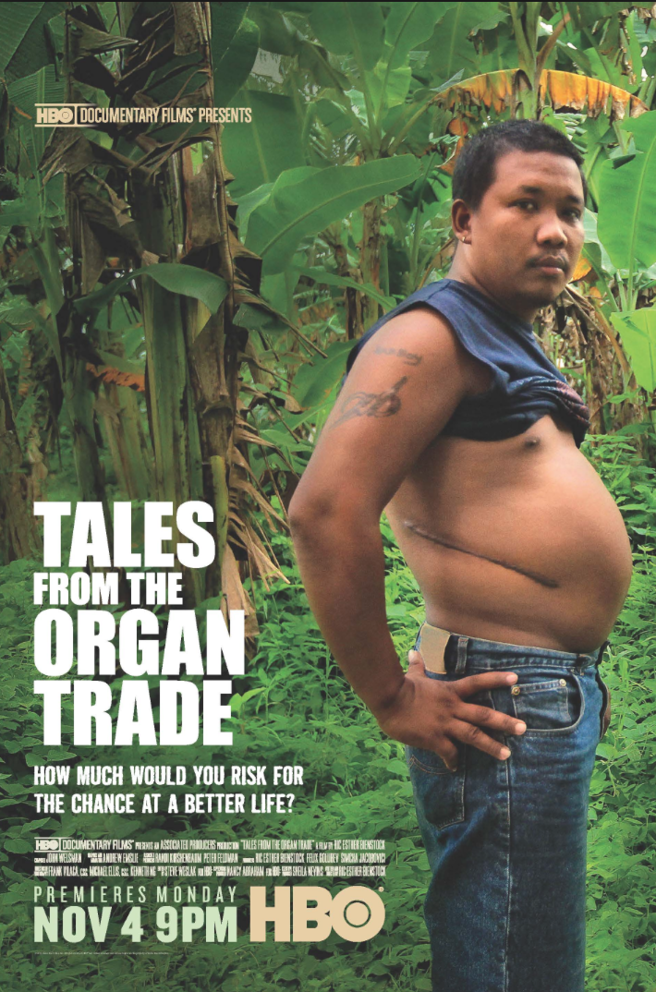
Selling Organs
JAMA, 2002
96% of people sold their kidneys to pay off debt
74% of people who sold their kidneys still had debt 6 years later
86% of people reported a deterioration in their health status after donation
79% would not recommend to others that they sell their kidneys

