Slide 1
Sheldon Krimsky Lenore Stern Professor of Humanities & Social Sciences,
Genetically Designed Babies &
Mitochondrial Disease
Miri Seminar
Tufts University
April 18, 2014

Slide 2
Historical Context
Since the publication of Splicing Life in 1982, the report of a national bioethics advisory committee, there was a widely recognized moral principle preventing eugenics--transforming human beings through genetics.
Introducing genes into a fully formed person—into their somatic cells was viewed as closer to drug therapy than genetically modifying sperm, egg or embryo.

Slide 3
Somatic Cell Germ Line
Gene Therapy Gene Therapy
MORAL BOUNDARY

Slide 4
“Zygote therapy would thus involve an alteration of the genetic inheritance of future generations and a significant departure from standard medical therapy.” (p. 46).

Slide 5
Weakening the moral boundary
As time progressed, some scientists and bioethicists began to question whether the restriction against genetically modifying babies --gametes/embryos was the correct ethical boundary.

Slide 6
A new proposal was introduced: The distinction became enhancement vs. therapy. In other words if the intervention was designed to “cure” or “repair” the gamete or embryo, that would be permissible; but if it were to enhance it, it would not.
The term was “enhancement eugenics”

Slide 7
Even that moral position did not hold. One journal editor and leader in the field of human gene therapy wrote: the real distinction should not be enhancement vs. therapy but whether the modification changes “our humanness.”

Slide 8
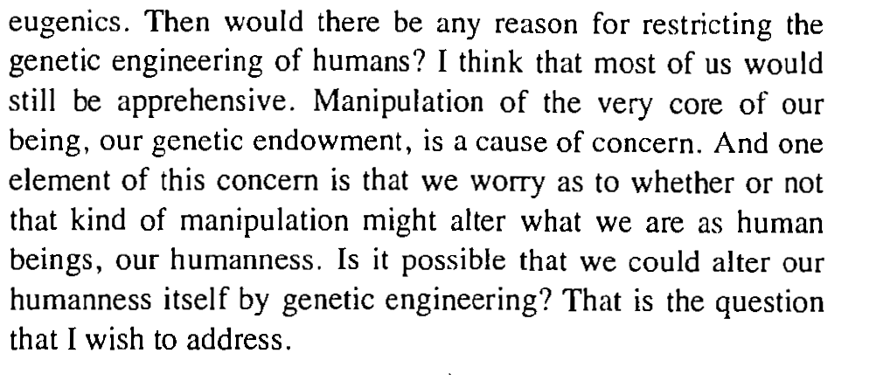

Slide 9
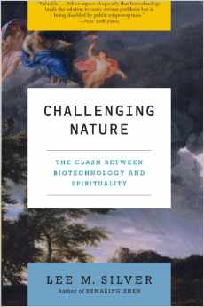
And some scientists, declared that there should be no barriers to transforming human beings—to create a new human through genetics.

Slide 10
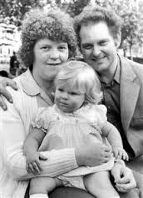
Late 1990s: Ooplasmic Transfer in Women
Since the first IVF birth in England in 1978—Louise Brown, IVF has been one of the fastest growing assisted reproduction technologies in the world.

Slide 11
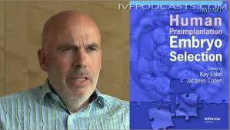
St Barnabas Medical Center, which goes back to 1865, houses the Institute for Reproductive Medicine & Science—considered one of the nation’s largest fertility centers. Dr. Jacques Cohen, an embryologist of the Institute, developed a technique in the 1990s called the cytoplasmic (or ooplasmic) transfer: the contents of a fertile egg from a donor are injected into the infertile egg of the patient who has undergone unsuccessful attempts of IVF along with the sperm.[

Slide 12
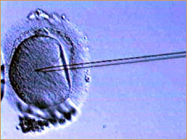
Cytoplasmic Transfer
Cytoplasmic Transfer : A technique in which cytoplasm from a donor egg is drawn into a pipette containing a single sperm from the male partner, after which that donated cytoplasm and the sperm are injected into the patient's egg.

Slide 13
Reasons for Cytoplasmic transfer
To improve chances of pregnancy—enhance fertility
To prevent the transfer of mitochondrial disease to the newborn.
(mitochondria generate ATP from food sources)
ATP= adenosine triphosphate; provides energy to cells

Slide 14
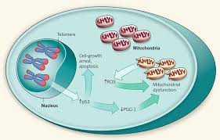
Mitochondrial Disease
The mitochondria are cells in the cytoplasm—sometimes hundreds. Each cell has 37 genes compared to 20-30,000 in the cell’s nucleus.

Slide 15
Mitochondria are responsible for creating more than 90% of the energy needed by the body to sustain life and support growth.

Slide 16
The mother might not be affected or may be mildly affected by mitochondria that are mutated—but the child born to her might be highly affected.
By transferring mitochondria from a donor cell to the mother’s cell, the good mitochondria can overwhelm the abnormal mitochondria. (the sour milk analogy).

Slide 17
First child born with ooplasmic transfer
In 1997, Cohen & Colleagues at St. Barnabas Hospital reported the first human pregnancy following cytoplasm transfer from donor oocytes into eggs of a patient with a history of fertility problems.
Levy & Yves, 2003.

Slide 18
The authors stated that “these are the first reported cases of germline mtDNA genetic modification which have led to the inheritance of two mtDNA populations in the children resulting from ooplasmic transplantation.”
Whether all these children are entirely healthy, however, remains unclear, and no follow up studies have been completed to verify the results.

Slide 19
The lack of testing and long -term followup of the children born from the procedure so far is a significant shortcoming, making evaluation of the safety and effectiveness of the technique very difficult.

Slide 20
FDA stops ooplasm transfer
Two babies at St. Barnabas had detectable mitochondrial DNA heteroplasmy—considered by many reproductive biologists as a risk factor for the offspring.
In 2001 a letter from FDA/DHHS went to IVF clinics and researchers: “We want to advise you that the [FDA] has jurisdiction over human cells used in therapy involving the transfer of genetic material by means other than the union pf gamete nuclei.” FDA cited ooplasm transfer as one of the examples.

Slide 21
FDA wrote:
“The use of such genetically manipulated cells (and/or their derivatives) in humans constitutes a clinical investigation and requires submission of an Investigational New Drug application (IND) to FDA”

Slide 22
Meanwhile other procedures for treating mitochondrial disease were being tested on animals.
While the FDA was considering the proposals on ooplasmic transfer, other procedures were developed to treat mitochondrial disease.
Oooplasmic transfer
Pronuclear Transfer (PNT)
Maternal Spindle Transfer (MST).
PNT & MST involve scooping up the nuclear DNA of the mtDNA-damaged egg and transplanting it to an enucleated donor egg.
What they all have in common is a three genome baby—two female mt genomes, 1 female nuclear genome and 1 male nuclear genome.

Slide 23
In the pro-nuclear transfer, you take the sperm and egg (fertilized) from intending parents. You extract two pronuclei; then you take a donor egg and sperm from intending father (fertilized). Remove pronuclei from donor egg.
Replace the pronuclei with that of intending parents.
Now you have an egg with healthy mitochondria.
In Material Spindle Transfer, the spindle (haploid chromosome) is removed from intending mother’s egg and transferred into an enucleated donor egg (spindle removed). Now the mother’s nuclear DNA is in an egg with healthy mitochondria. Intending father’s sperm fertilizes the egg.

Slide 26
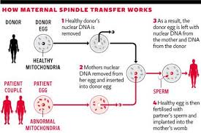

Slide 27
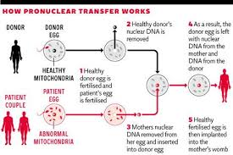

Slide 28
Shoukhrat Mitalipov has developed a procedure to help women conceive without passing on their genetic defects.
Dr. Mitalipov’s (National Primate Center in Oregon) procedure would allow these women to bear children by placing the nucleus from the mother’s egg into a donor egg whose nucleus has been removed. The defective mitochondria, which float outside the nucleus in the egg’s cytoplasm, are left behind.

Slide 29
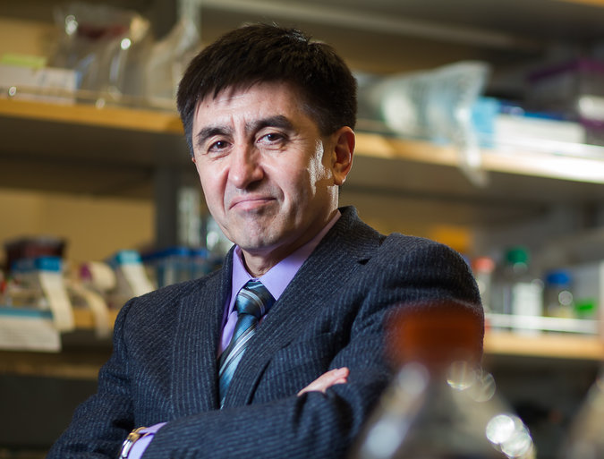
Shoukhrat Mitalipov, National Primate Center in Oregon

Slide 30
Concerns about 3-Genome Babies
Risks of heteroplasmy
Communication between nuclear and \
mt DNA
Beginnings of germ line gene modification

Slide 31
Cytoplasmic transfer appears to be consistently associated with mitochondrial heteroplasmy (Scott and Alkani, 1998).
Heteroplasmy—or babies born with two distinct female mitochondrial genomes, is a risk which must be understood before cytoplasmic transfer aka ooplasm transfer is considered for clinical practice.
While an estimated 30 babies have been born using the technique there have been no systematic follow-up studies that examine the rate and degree of heteroplasmy in the newborn and in cases where it exists on its effect on the developmental health of the child.

Slide 32
Heteroplasmy created by the mixture of cytoplasm from different strains of mice resulted in physiological impairment, including disproportionate weight gain and cardiovascular system changes.
Cytoplasmic transfer used in cattle produces heteroplasmic offspring (Ferreira et al. 2010).
Some children born through cytoplasmic transfer have been identified as heteroplasmic (Levy et al. Human Reproduction 2004).
Mixing of two different mouse mitochondrial DNA within the same female germline can lead to offspring with neuro-psychiatric defects (Shapely et al. CELL 2012)..

Slide 33
Mitochondrial heteroplasmy
“Infusion of 3rd party mitochondria itself or with deletions and/or mutations could theoretically increase the risk of mitochondrial hteroplasmy” (Chappel, Obst & Gyn Int 2013).
“Metabolic abnormalities in offspring may have been due to the differences in response to nuclear signals between the two populations of mitochondrial DNA.” Chappel, Obst & Gyn Int, 2013).

Slide 34
“Mice show significantly altered basic physicological functions when in a heteroplasmic state.”
Ferrera et al Biol of Reprod, 2010
“heteroplasmic animals had increased body mass and fat mass compared to controls at all ages…had abnormalities in electrolytes and hematologic parameters.”
Acton et al. Biol of Reprod, 2007

Slide 35
“There are concerns that cytoplasmic transfer could cause major epigenetic modifications, and two of the first 16 pregnancies involving cytoplasmic transfer had chromosomal abnormalities.”
Brown et al, The Lancet, 2006

Slide 36
“Cytoplasmic transfer is still an experimental technique that, while offering treatment to some infertile couples, is equally capable of generating unexpected abnormalities.”
St. John, Human Reproduction, 2002

Slide 37
Nuclear Transfer to Treat Prevent mitochondrial disease in the offspring
“Some of the deficient mitochondria from the woman with mitochondrial disease may be transferred to the enucleated egg, causing mitochondrial heteroplasmy. This could result in mitochondrial disease developing either in the child or in future generations. Although Craven et al (2010)1 found that embryos created by transfer of pronuclei using abnormally fertilised eggs had less than 2% carry-over of mitochondrial DNA and some had no detectable carry-over, as pointed out in the Nuffield ‘Scientific review of the safety and efficacy of methods.”

Slide 38
“To avoid mitochondrial disease through assisted conception’ there is evidence that at least in some cases there can unexpectedly be preferential multiplication of unhealthy mitochondria. Craven et al were unable to investigate this. However, if preferential multiplication were to occur, it could increase the risk of mitochondrial disease either in the child over time, or in future generations.”

Slide 39
Questions to be answered
Is ooplasmic transfer safe and effective for the offspring?
If the procedure is found to be generally safe but with some risks, do prospective parents have the authority to undertake the procedure, balancing risks and benefits, without additional oversight.
Are the potential benefits of ooplasm transfer for improving fertility or preventing the transfer of mitochondrial disease unique and sufficient to open the door to germ line genetic modification. What will be next—trying to make babies more intelligent?

Slide 40
International treaty on genetically modifying the human genome
Inheritable Genetic Modification (IGM) is prohibited by the Charter of Fundamental Rights of the European Union, the Council of Europe’s Oviedo Convention on Biomedicine and Human Rights, the United Nations Education, Scientific, and Cultural Organization’s Universal Declaration on the Human Genome and Human Rights, and other instruments of international law. Supported by 40 countries.

Slide 41
Options for prospective mother with mt disease
Obtain donor egg with partner’s sperm
Have prenatal genetic diagnosis on intending mother’s eggs to determine the eggs with least mt mutations.
adopt a child
Go through ooplasmic transfer; MST, or PNT

