Slide 1
The Ethics of Human Enhancement
THE CENTER FOR ETHICS EDUCATION
CELIA B. FISHER, PH.D., DIRECTOR
Elizabeth Yuko, Ph.D., LL.M. Center for Ethics Education
www.fordham.edu/ethics

Slide 2
What is enhancement?
Where does therapy end and enhancement begin?
What is “normal”?
What is considered “good health” today versus 50 or 100 years ago?

Slide 3
3 Categories of Enhancement
Health Status (vaccines, clean water, protection against coronary disease)
Extension of Abilities (doping in sports, mood/cognitive enhancement, body modification)
Transhumanism

Slide 4
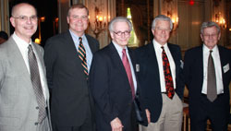
Principles of Biomedical Ethics
Respect for autonomy
Non-maleficence
Beneficence
Justice

Slide 5
Sports Enhancement
Should doping or physical enhancement be allowed in sports?

Slide 6
What is doping?
Doping = use of biomedical technology to enhance performance other than by treating or preventing disease
Fun fact: Probably derived from the Dutch word dop, the name of an alcoholic beverage made of grape skins used by Zulu warriors in order to enhance their prowess in battle.
Term became current around the turn of the 20th century, originally referring to illegal drugging of racehorses.
The practice of doping is as old as competitive sport itself.

Slide 7
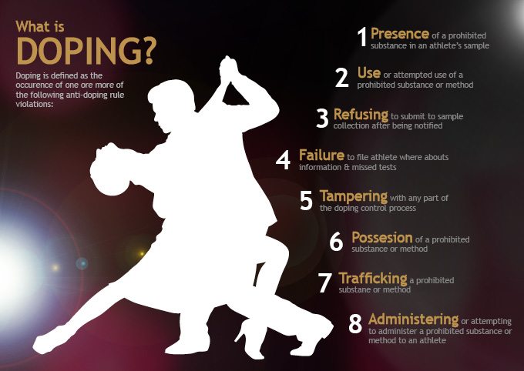

Slide 8
History
2-300 BC Stimulant use by competitors in the ancient Olympics
1896 1st reported death due to doping (Bordeaux-Paris cycle race)
1904 Winner of Olympic marathon took injections of strychnine
1924 1st Tour de France doping scandal: Pélissier brothers
1968 US track & field team: est. 33% had used steroids
1987 US track & field team (women): est. 40% had used steroids
2015 WADA report finds systematic doping in Russian track & field team

Slide 9
Sports are the first area in which enhancement has been heavily regulated.

Slide 10
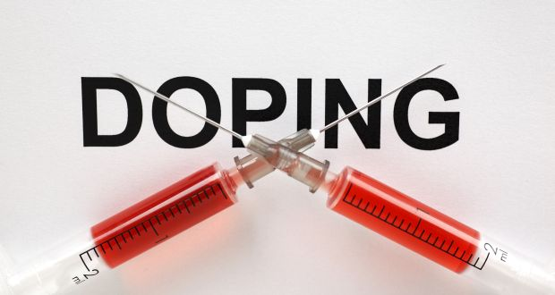
The response to doping
1928 IAAF (International Association of Athletics Federations) bans doping
1st compulsory doping controls in Olympics
Present WADA policy of “zero tolerance”

Slide 11
Who makes the rules against doping?
WADA: World Anti-Doping Association Established in 1999 as an international independent agency composed and funded equally by the sport movement and governments of the world. Monitors World Anti-Doping Code – the document harmonising anti-doping policies in all sports and all countries.
IOC: (International Olympic Committee) Issues lists of forbidden substances and checks for banned substances during competitions

Slide 12
WADA: Rationale behind the Code
Anti-doping programs seek to preserve what is intrinsically valuable about sport. This intrinsic value is often referred to as "the spirit of sport," it is the essence of Olympism; it is how we play true.
Doping is fundamentally contrary to the spirit of sport

Slide 13
So why not just enforce anti-doping policies?
This is the response favored by sporting officials and the public.
Unfortunately, many anti-doping policies are unenforceable.
Athletes can find ways around bans; it is highly unlikely that regulators will ever be able to end doping completely.

Slide 14
Would doping be unfair if legal?
Must determine what should and should not determine the outcome of sports competitions.
But is sport unfair no matter what, given that some athletes have certain genetic traits that give them advantages? Will the playing field ever truly be level? (bonus sports reference)

Slide 15
Is doping cheating?
Cheating: “the intentional violation of a rule in order to gain an unfair advantage over others.” (Green 2004).
Currently, yes: when athletes dope, they are, in most cases, breaking the rules of that sport, which therefore constitutes cheating.
Cheating relies upon a set of rules. If the rules were changed, the definition of cheating would also change.
If doping were legalized & part of the rules, would it be cheating?

Slide 16
What should determine outcomes in sport?
Natural ability?
Effort/Training/Practice?
A combination of natural ability and effort?
If the latter is true, then are virtually all sports competitions unfair, as outcomes are partially determined by other factors? (i.e. quality of coaching and equipment, access to training facilities, wealth & technological development of athlete’s society)

Slide 17
What should sports measure and/or celebrate?
Human excellence?
Natural ability (but what about those born with better genes than others)?
Could technologically-enhanced performance be seen as merit, combining natural luck and the clever use of technology?
Whether or not doping would “ruin” sports depends on what you think sports should be measuring.
Two Olympics?

Slide 18
Should sports embrace technology?
Certain sports (like Formula One racing) are based on advances in technology.
What about the claim that all sports ought to embrace technology? (What about deciding on a case-by-case basis?)
Would use of technology change the nature of the sport? (for example, using roller skates in a marathon)

Slide 19
Sports and technology
If doping were permitted, presumably more doping would occur than does at present. As a result, the absolute sporting outcomes (time taken, distance jumped, etc) would be attributable to technology rather than human performance.
Different competitors would have different access to doping, so relative outcomes would also be somewhat attributable to technology (assuming that doping would be expensive).

Slide 20
Doping in Horse Racing
Potential for both the jockey and horse to utilize enhancement

Slide 21
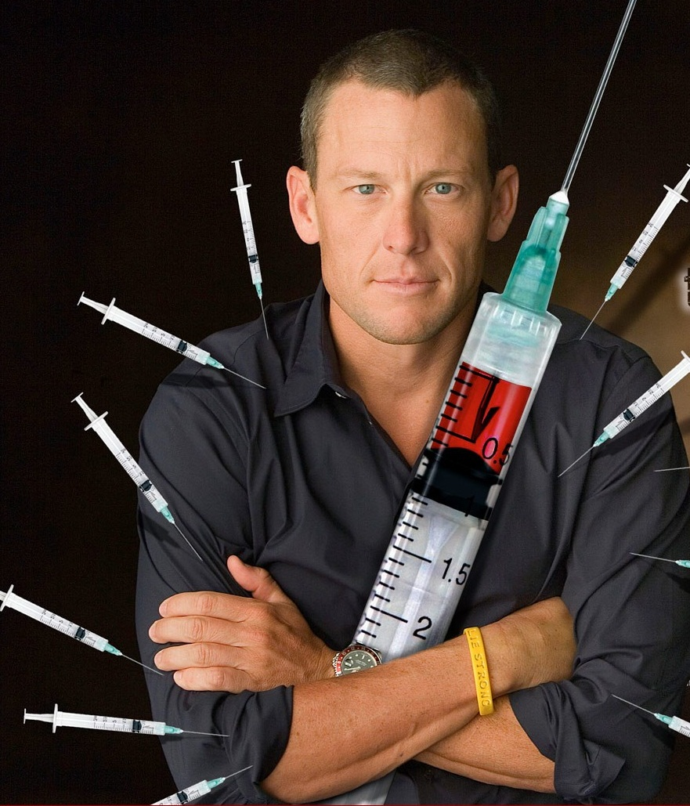
Is a strict anti-doping policy better than a permissive one?
What are the penalties for enhancing? Loss of contract? Loss of sponsorships? Do the potential benefits to enhancing outweigh the risks? If not, how do we make that the case?
The introduction of running shoes and graphite tennis racquets affected relative outcomes, but aren’t regarded as being unfair.

Slide 22
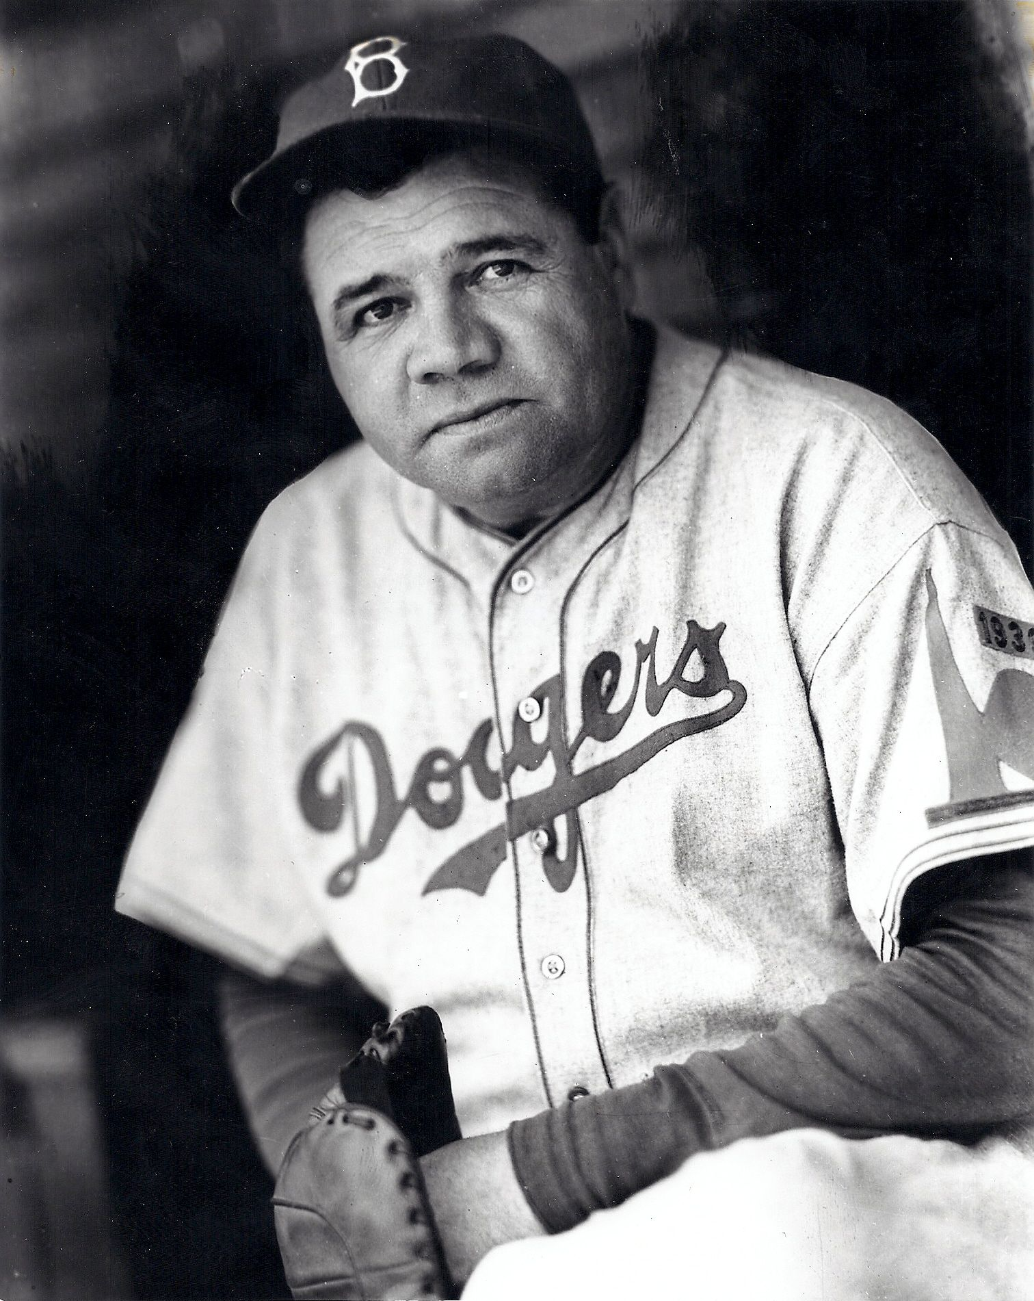
Is a strict anti-doping policy better than a permissive one?
From the point of view of fairness, relative outcomes resulting from technology seem more important.
What about inter-temporal fairness? Should this even be an issue? (Do we owe atheletes of the past anything?)

Slide 23
Arguments in favor of legalizing doping (under medical supervision)
Other factors that affect performance (i.e. biological and environmental factors) are unchecked. Good genes are acceptable, while drugs are not.
Sport is dangerous to athletes’ health regardless of whether drugs are taken.
In order to assess risks to athletes’ heath, every performance-enhancing drug must be studied. This cannot be done while they are illegal.
We could see how far we could push the human body.

Slide 24
More arguments in favor of legalizing doping
Line blurred between therapeutic and performance-enhancing drugs which causes difficulty for controlling bodies, along with costly administrative and medical follow-up.
A doctor’s role is to preserve patients’ present & future health, while maintaining as high a level of performance as possible. Doctors should not be punished for the use of performance-enhancing drugs, but should be held accountable for any ill effects.

Slide 25
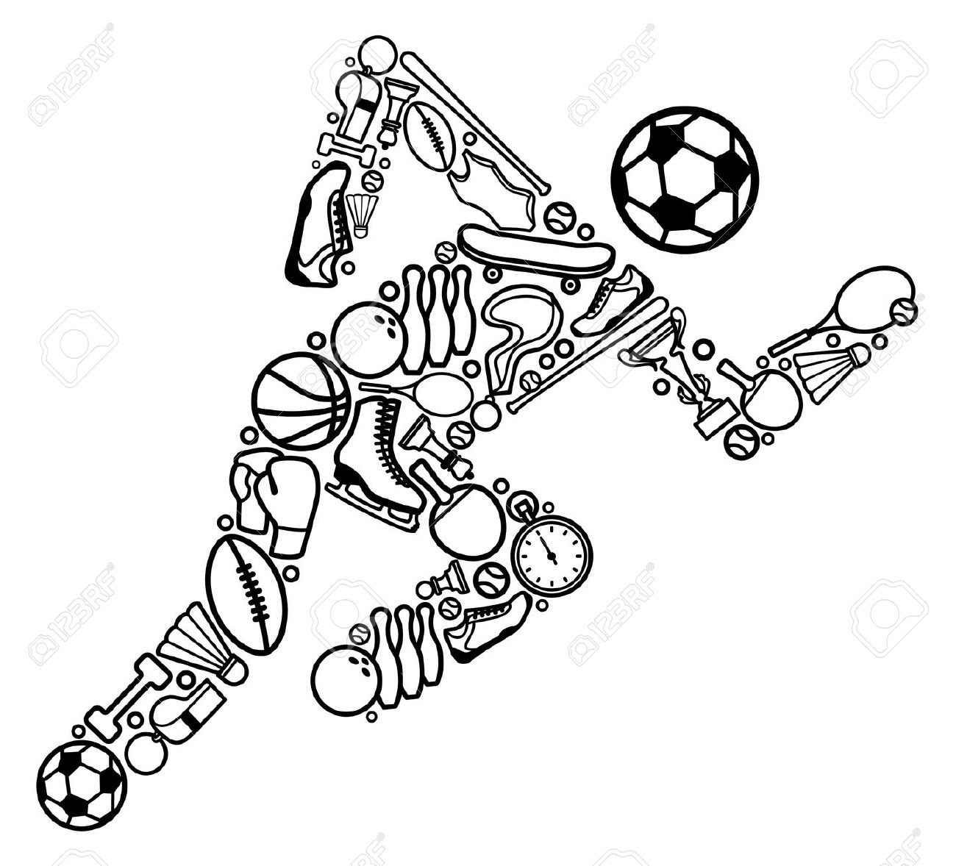
What are the options?
Step up the “war on doping”
Legalize doping
Or
Somewhere in the middle: legalize some drugs on a case-by-case basis

Slide 26
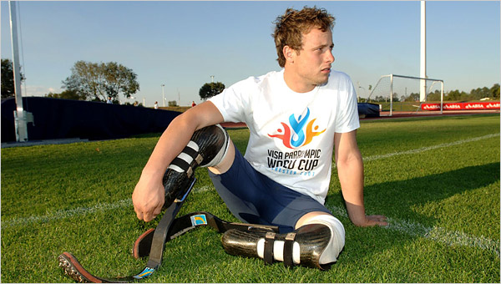
Physical enhancements: (Pre-Murder) Oscar Pistorius
Disabled or too-abled?
Therapy for Oscar, but does it come with an advantage?
Competed in both Paralympics and able-bodied events
First amputee runner to compete in Olympic Games (London 2012)
Also competed in 2012 Paralympics

Slide 27
How far will it go?
Will athletes enhance themselves by undergoing amputation and getting prosthetic legs on purpose?
Is it self-mutilation if you’re getting a better limb?
Would the nature of sport be altered if athletes using artificial limbs could run faster or jump higher than the best athletes using their natural limbs?

Slide 28
Body Modification
What should we be allowed to do with our bodies?
Which principles apply here?

Slide 29
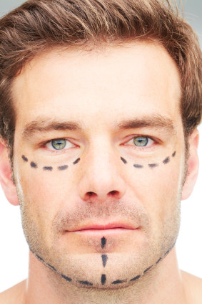
Cosmetic Surgery
Should doctors be permitted to perform cosmetic surgery? Why or why not?
NOT talking about reconstructive surgery following an accident, mastectomy, etc. but surgery for purely cosmetic purposes.

Slide 30
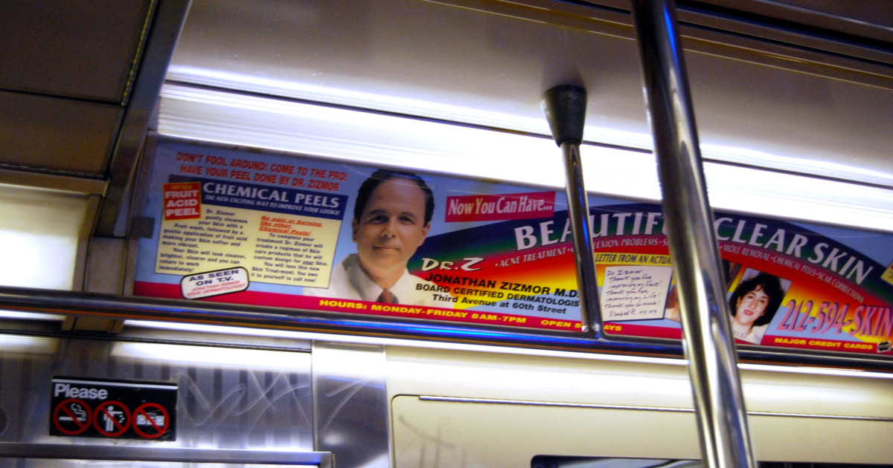
Cosmetic Surgery
How does it fit into the overall goals of medicine?
Potential risks, side effects, scar tissue, nerve damage, pain, future complications, long healing process, etc.
Business/marketing of procedures (consumers versus patients) (e.g. subway ads: “Made in NY” bosom; Dr. Zizmor)
Do patients have a right to receive whatever treatments they demand and are prepared to pay for?
How should cosmetic surgery be regulated? (If at all)

Slide 31
Body Identity Integrity Disorder

Slide 32
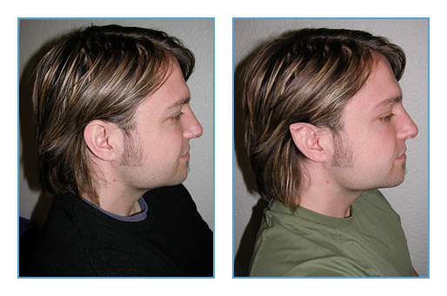
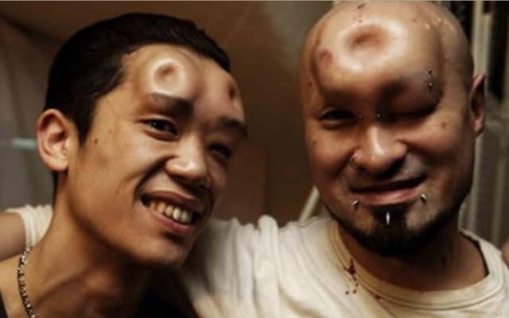
Other procedures
elf ears, saline face doughnut, scales, human branding, scarification, tattoos, piercings, hair cutting/removal

Slide 33
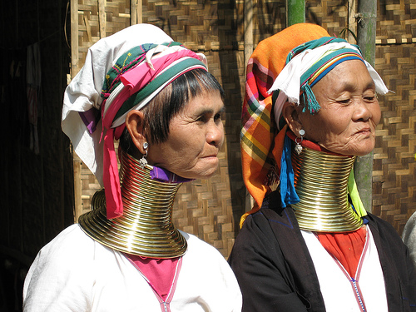
Other Body Modification Issues
What is the person performing the procedure isn’t a doctor?
Cultural differences?

Slide 34
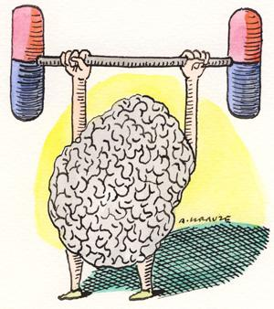
Psychopharmacological Enhancements
Moral enhancement
Mood enhancement
Cognitive enhancement
Enhanced punishment?

Slide 35
Moral Enhancement
Should people be permitted to morally enhance themselves via biomedical means?
Should we actively develop biomedical moral enhancement techniques?
Would we be able to prevent these technologies from being used to enhance self-interestedness or immortality?

Slide 36
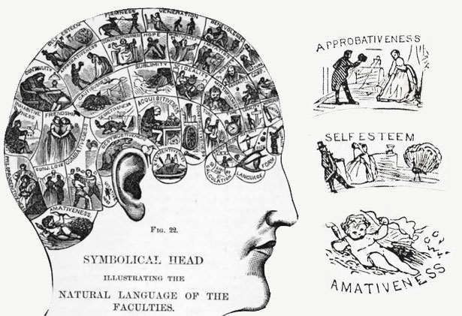
Moral enhancement
Douglas: “A person morally enhances herself if she alters herself in a way that may reasonably be expected to result in her having morally better future
motives, taken in sum,
than she would
otherwise have had.”

Slide 37
Cognitive Enhancement
Already in existence, but further developments can be made
Taking Ritalin/Modafnil to help with concentration/cram for exams
What about taking other existing supplements?
Ginseng, ginkgo biloba, Jessie Spano caffeine pills, coffee, etc.

Slide 38
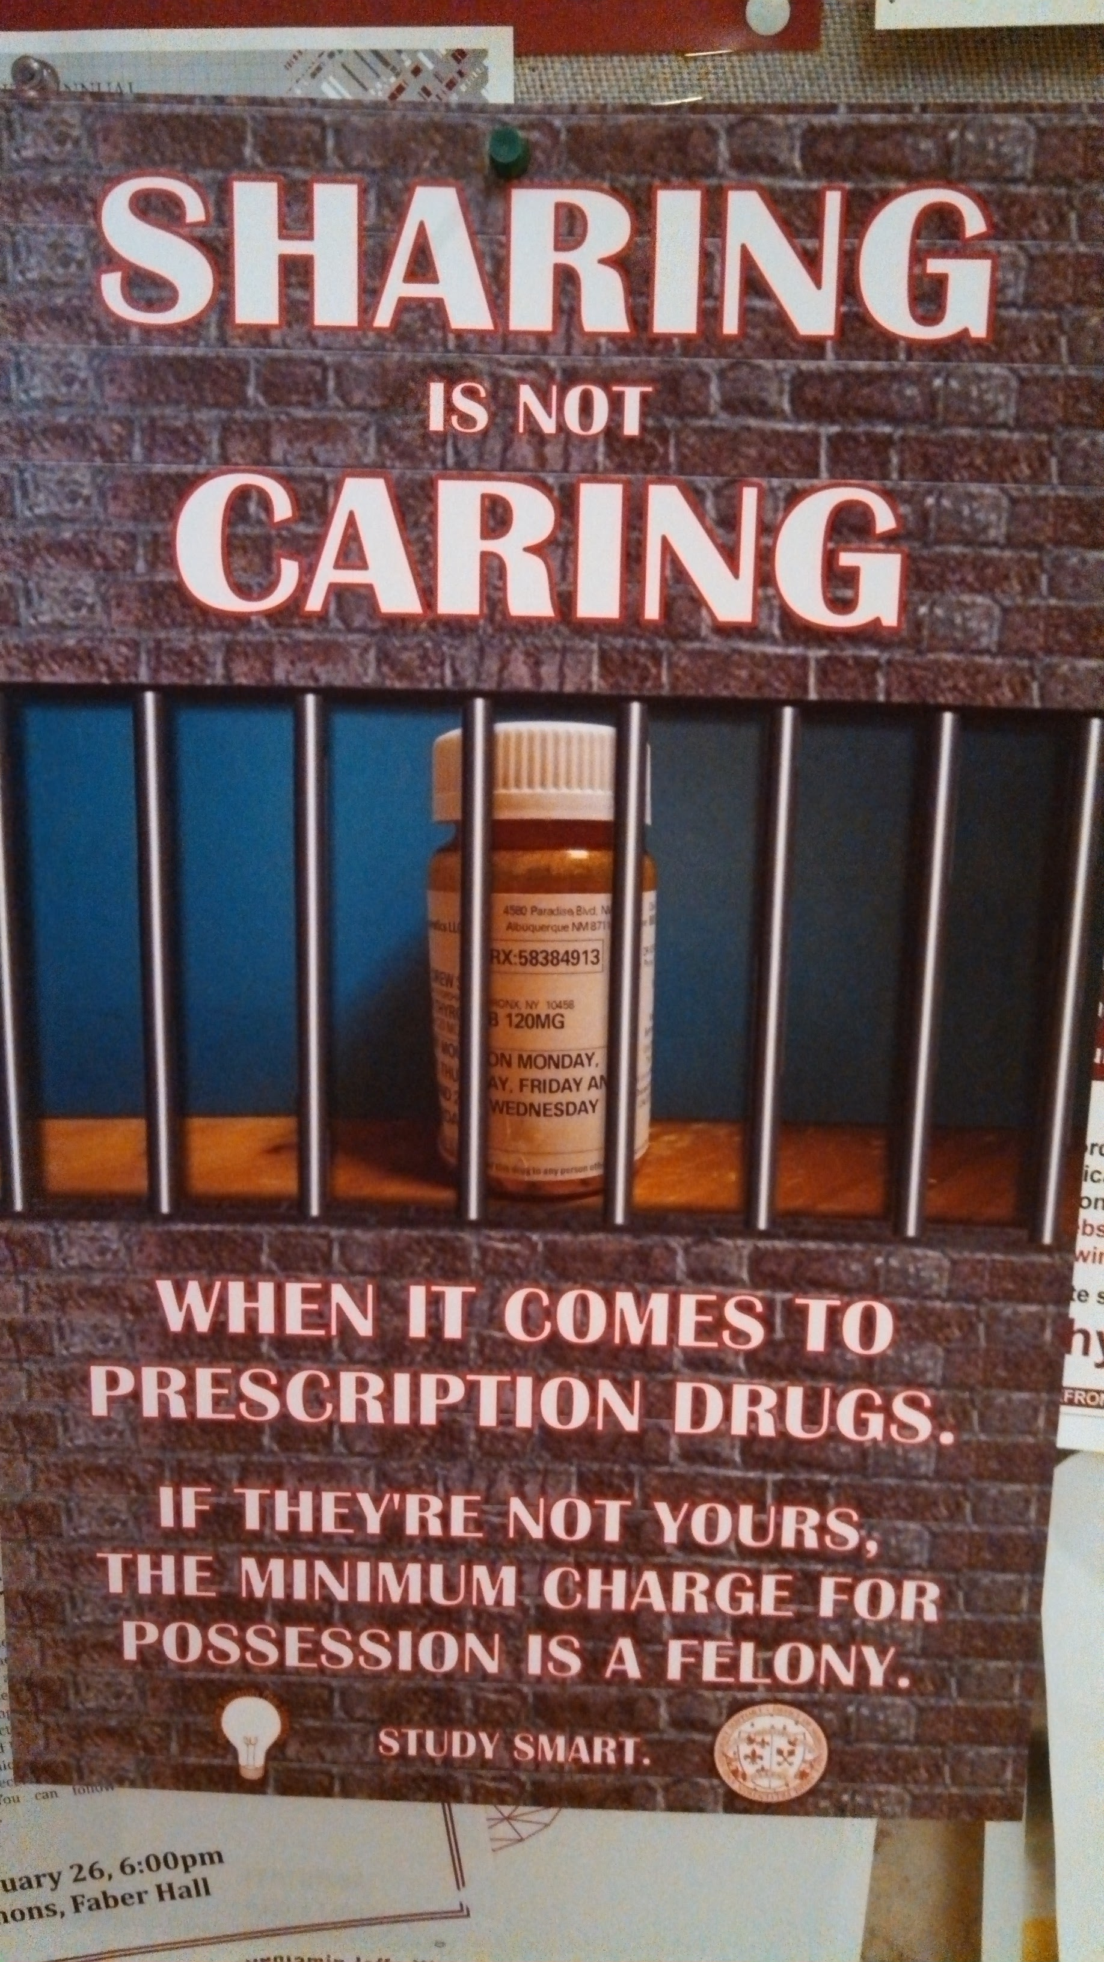
What does it entail?
Concentration
Alertness
Working memory
Long-term memory
Not enhancing intelligence
(at this stage)

Slide 39
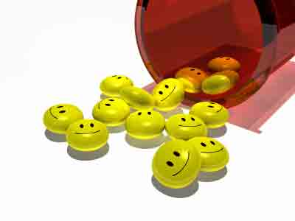
Mood Enhancement
Taking anti-depressants for non-therapeutic reasons
May not make you happy all the time, but may reduce negative affect (sadness, anxiety)
Soma in Brave New World
What happens if you can’t feel negative emotions/feelings?

Slide 40
Development of cognitive/mood enhancements
Will not take place under the banner of “enhancements” (at least initially)
Under current regulations, development of enhancement-specific drugs not opportune for pharma companies
But disease-centered approach impedes development of safe/effective enhancing medicines (Bostrom)
Shifting mental health disease categories

Slide 41
Cognitive & Mood Enhancement: Ethical Issues
Safety/risks (both long and short term)
Justice/equal opportunities
Coercion and social pressure (What if everyone else is taking them? Will you need to enhance to keep up with school/work?)
Identity and authenticity

Slide 42
More ethical issues
Should governments prohibit or promote enhancement research?
May doctors prescribe off-label for enhancement purposes?
What about non-prescription use? How could/should that be regulated?
Taking medication for therapeutic purposes with bonus enhancing side effects?
Is using cognitive enhancers cheating?

Slide 43
Reproductive Enhancement
Assisted/artificial reproduction
Using medical technology to assist people in various stages of the reproduction process (i.e. gamete donation, IVF)

Slide 44
Is reproductive medicine human enhancement?
Can be for both therapeutic and enhancement purposes
Most assisted reproduction is currently therapeutic (fertility treatment)
Potential to move towards enhancement

Slide 45
Purpose
Assisted or artificial reproduction can range from therapeutic treatment for the infertile, to entirely enhancement, and everything in between
Will increased technological capabilities end up limited freedom/autonomy in any way?

Slide 46
Therapy vs. Enhancement
Is infertility/inability for a person/couple to have children a disease/disability?
Is procreation a right?
Evolving concept of what it means to be a family

Slide 47
History of assisted reproduction
1785: child born after artificial insemination
Early 1950s: methods for cryopreserving human semen and performing artificial insemination were refined
1963: IVF with rabbits
1972: first human embryo transfers
1978: birth of Louise Brown, first IVF baby
1984-1985: first babies born after transfer of embryos that had been frozen and thawed
1988: PGD introduced
Mid-1990s: intracytoplasmic sperm injection/assisted fertilization

Slide 48
Enhancement: Reprogenetics
The merging of reproductive and genetic technologies.
Currently: genetic screening, but has the potential for genetically-enhanced future generations.

Slide 49
Reprogenetics
Screening for genetic diseases is a mild form of enhancing & generally acceptable for more serious genetic illnesses.
But what about milder/treatable genetic conditions? Gender? Physical characteristics (hair/eye color, etc.)

Slide 50
Pre-implantation genetic diagnosis
PGD: Pre-implantation genetic diagnosis
Screening embryos for genetic characteristics prior to implantation in a uterus

Slide 51
What should parents be permitted to select via PGD?
Embryos without physical & developmental chromosomal diseases (Down Syndrome, Huntington’s)?
Embryos without physical genetic diseases that appear immediately (CF, Muscular Dystrophy)?
Embryos without genes that indicate that they may have an inherited disease later in life (cancer, heart disease)?
Embryos of a certain gender because of gender-specific chromosomal disorders?

Slide 52
What should parents be permitted to select via PGD?
Embryos without less serious illnesses (asthma, obesity, arthritis)?
Embryos with/without certain physical characteristics (height, hair color, eye color)?
Embryos with/without certain intellectual characteristics (IQ, empathy, morality)?
Embryos of a certain gender?
Embryos WITH a certain mutation (dwarfism, deafness)?

Slide 53
Reprogenetics – future repercussions
PGD requires IVF
If PGD were the norm, then anytime it was used, IVF would also have to be used
IVF is far more invasive, expensive, inefficient, etc than traditional conception
Could PGD/IVF be the norm in the future?

Slide 54
Implications of reprogenetics
What would it mean for the human species/society?
Would a woman becoming pregnant the traditional way seem outdated or even unsafe/irresponsible?
For women: pregnancy & childbirth are difficult enough; this would add another difficult dimension (IVF) to reproduction
Would it create two classes of people: the enhanced and the unenhanced?

Slide 55
Autonomy and reprogenetics
If genetic enhancing existed which could ensure that a child would be born healthy without any medical problems, could a woman refuse to undergo PGD and IVF?
What would this mean for autonomy?
Could a woman genuinely choose to refuse granting her child a healthier outcome? Would/should she have a say in the way she conceives?

Slide 56
Other examples of assisted reproduction (currently in use)
Controlled Ovarian Stimulation (COS)
Intracytoplasmic Sperm Injection (ICSI)
Gamete donation
In vitro fertilization (IVF)
Surrogacy

Slide 57
Artificial Wombs
An external device used for the partial or complete gestation of an embryo/fetus
Therapeutic and enhancement purposes
Process: ectogenesis

Slide 58
Artificial Wombs
Early artificial wombs exist in the form of incubators for extremely premature babies
Technology advances, age of viability decreases
Fetal/embryo transplants
Eventually leading to complete ectogenesis from IVF embryo to baby
Also, womb transplantation?

Slide 59
Is research on artificial wombs taking place?
Most research is being conducted into artificial wombs indirectly, through research in the areas of IVF, fetal medicine, tissue engineering, neonatal care, gynaecology, embryology, computer science, the human genome project, and other related areas.

Slide 60
Has there been any research specifically on artificial wombs?
Thomas Schaffer, a neonatal physiologist, attempted to develop an artificial amniotic fluid which would help neonates survive longer in the early 1980s.
Yoshinori Kuwabara of the University of Tokyo used an artificial placenta to maintain mid- to late-stage goat foetuses, which were held in a tank of amniotic fluid and nourished through catheters in 1990.
Hung-Ching Liu of Cornell University began to grow an artificial womb using cells removed from a woman’s uterus, hormones and growth factors in 2001.

Slide 61
Valuable goals
Assisting the infertile (therapeutic)
Assisting premature babies (therapeutic)
As an alternative to the death of the foetus following abortion of a pregnancy
Having a safe/controlled environment during gestation
Women would not have to be pregnant (enhancement)

Slide 62
Valuable goals
May decrease gender inequality
Benefit fetal medicine
Partially grow embryos/fetuses to farm organs/tissues for transplant
Allows homosexual couples to have their own genetic children without a surrogate
Expand reproductive options/autonomy

Slide 63
Yes, there are valuable goals, but are the ethical issues resulting from artificial wombs surmountable?

Slide 64
Ethical issue: Experimental treatment
How will artificial wombs come into existence?
Gradual process
Benefit/harm & consent
Begin with embryos/foetuses/neonates that would have died anyway
1st instance of full ectogenesis: experimental fertility treatment

Slide 65
Ethical issue: experimental treatment
What determines where the set of guidelines and ethics established for neonatal intensive care (using incubators) ends, and where would experimental treatment on foetuses using artificial wombs begin?
Is the current treatment of neonates experimental treatment, as the outcome of the treatment is usually unknown?

Slide 66
Ethical Issue: Impact on Abortion
A solution to abortion? Autonomy? Cost?
Ending an artificial pregnancy
Impact on abortion regulation

Slide 67
Ethical issue: Commercialization/Commodification
Of babies/fetuses?
Growing foetuses for body parts?
Growing babies/fetuses for research?
Lab-grown babies could be more easily manipulated/enhanced → commodified

Slide 68
Ethical issue: welfare of the ectogenic child
Similar to concern pre-IVF
Possible physical, emotional, psychological effects on child
How would society view them?
A class issue?
No mother/child bond from pregnancy?

Slide 69
Other ethical issues
Prohibitive cost
Eligibility for/access to artificial wombs
Stigmatisation of users/non-users of artificial wombs
Liability

Slide 70
Other ethical issues
Unnaturalness
Terminating an artificial pregnancy
Ownership of embryo/fetus
Potential for eugenic program/cloning

Slide 71
Thank you!
Dr. Elizabeth Yuko Center for Ethics Education Fordham University eyuko@fordham.edu @elizabethics ethicsandsociety.org

Slide 72
Thank you!
Dr. Elizabeth Yuko Center for Ethics Education eyuko@fordham.edu @elizabethics ethicsandsociety.org

