Slide 1
Ethical issues in the treatment of eating disorders.
D. Catherine Walker, Ph.D.
Visiting Assistant Professor of Psychology, Union College
Licensed Clinical Psychologist, HPA/Live Well

Slide 2
Discussion Overview
What are eating disorders?
Medical complications.
Multidisciplinary treatment
Balancing Autonomy and Beneficence
Training
Are we successfully training enough practitioners?
Treatment
Are treatment centers and practitioners providing the best available care?
Managed care
How does the health care industry impact treatment?

Slide 3
My thoughts when Dr. Lita contacted me about coming to speak with GBI’s summer program about eating disorders.
What is Bioethics?
How do eating disorders fit in?
How can we (eating disorders practitioners; more broadly, society) benefit by looking at the treatment of eating disorders through the lens of bioethics?
Notes:
Thoughts as I was asked to do this:
I am not a bioethicist.
I have never even taken a bioethics course.
→ What really is the field of bioethics and → where do eating disorders fit into this?
By July 18th of this program, it’s been in full swing and perhaps this is a question that many of you can actually speak to better than I, having sat and heard many prominent medical doctors in relevant fields and experts in the field of bioethics.
But, what I do have, is expertise in the treatment of eating disorders. And I asked myself about what ethical issues I have seen in my time treating eating disorders and what I have heard about through clients and from other practitioners.

Slide 4
Discussion Overview
What are eating disorders?
Medical complications.
Multidisciplinary treatment
Balancing Autonomy and Beneficence
Training
Are we successfully training enough practitioners?
Treatment
Are treatment centers and practitioners providing the best available care?
Managed care
How does the health care industry impact treatment?

Slide 5
Group activity / Introductions
What do you know (or think you know, but maybe are not 100% sure about) about eating disorders?
Get into groups of 4-5
Discuss (and write down) what you know as a group about eating disorders.
We will come back and share group insight and knowledge together after everybody is done.
Notes:
I wanted to start by getting a sense of what those of you here know about eating disorders and to learn a little bit more about each of you and what brought you here to this summer program first.
So, would you mind telling me your name, what brought you here, any other relevant information (where you attend school or work), any prior knowledge on eating disorders you feel comfortable sharing (coursework/work/life experience)
→What do you know (or think you know, but maybe are not 100% sure about) about eating disorders?
Get into groups of 3-4
Discuss (and write down) what you know as a group about eating disorders.
We will come back and share group insight and knowledge together after everybody is done. And then I’ll go through the diagnoses in a little more detail.

Slide 6
What is a feeding or eating disorder?
“Feeding and eating disorders are characterized by a persistent disturbance of eating or eating-related behavior that results in the altered consumption or absorption of food that significantly impairs physical health or psychological functioning.”
- American Psychiatric Association. (2013). Diagnostic and statistical manual of mental disorders (5th ed.). Washington, DC.
Notes:
Read quote and explain the DSM 5

Slide 7
Feeding and Eating Disorder Diagnoses DSM 5
DSM 5:
Pica
Rumination disorder
Avoidant/restrictive food intake disorder (ARFID)
Anorexia nervosa (AN)
Bulimia nervosa (BN)
Binge eating disorder (BED)
All but Pica are mutually exclusive by definition
Differ in course, outcome/prognosis, and treatment
Note: Obesity is not an eating disorder.
Notes:
As I am filling in information from what you already knew about eating disorders from the DSM5 and from some clinical descriptions of common symptoms/typical cases, feel free to jump in and ask questions or offer thoughts/comments. Otherwise, this brief tour of the DSM gets pretty boring!
1. First group are disorders that are more commonly occurring in infancy or childhood. They are less common in adults, other than those with developmental or intellectual disabilities. These aren’t the main focus of what I do or will talk about but I figured I would explain them briefly, so we know what we are and are not talking about this afternoon.
Does anybody know what Pica is?
Persistent eating of nonnutrivite, nonfood substances over a period lasting at least 1 month.
Does anybody know what Rumination disorder is?
Repeated regurgitation of food over a period of at least 1 month. Regurgitated food may be re-chewed, re-swallowed, or spit out.
ARFID – I am guessing people have not heard of before, but its name describes the diagnosis relatively well.
An eating or feeding disturbance (e.g., apparent lack of interest in eating or food; avoidance based on the sensory characteristics of food; concern about aversive consequences of eating) as manifested by persistent failure to meet appropriate nutritional and/or energy need
The primary eating disorders that more typically arise during adolescence and adulthood are AN, BN, & BED
Note that Obesity is not an eating disorder.
PICA: [B. The eating of nonnutritive, nonfood substances is inappropriate to the developmental level of the individual.
C. The eating behavior is not part of a culturally supported or socially normative practice.
D. If the eating behavior occurs in the context of another mental disorder (e.g., intellectual disability [intellectual developmental disorder], autism spectrum disorder, schizophrenia) or medical condition (including pregnancy), it is sufficiently severe to warrant clinical attention.
Specify if:
In remission: After full criteria for pica were previously met, the criteria have not been met for a sustained period of time.
Diagnostic Features
Typical substances vary with age and availability.
Ex: paper, soap, cloth, hair, string, wool, soil, chalk, talcum powder, paint, gum, metal, pebbles, charcoal/coal, ash, clay, starch, or ice.
Suggested minimum age of 2 years old
Prevalence
Unknown! Greater prevalence in individuals with intellectual disability associated with greater severity of disability
Development and Course
Onset – childhood (can be typically developing children), adolescence, or adulthood (typically with intellectual disability).
Pregnancy – Dx if harm occurs
Course: may be long, often Dx only when medical complications
Prognosis: dependent on substance and quantities ingested; can be very harmful or fatal!]
RUMINATION DO:
[B. The repeated regurgitation is not attributable to an associated gastrointestinal or other medical condition (e.g., gastroesophageal reflux, pyloric stenosis).
C. The eating disturbance does not occur exlcusively during the course of anorexia nervosa, bulimia nervosa, binge-eating disorder, or avoidant/restrictive food intake disorder.
D. If the symptoms occur in the context of another mental disorder (e.g., intellectual disability [intellectual developmental disorder] or another neurodevelopmental disorder), they are sufficiently severe to warrant clinical attention.
Specify if:
In remission: After full criteria for regurgitation disorder were previously met, the criteria have not been met for a sustained period of time.
Diagnostic Features
In older children, adolescents, and adults, sometimes described as habit or out of individual’s control
May lead to social impairment
Prevalence
Unknown! Greater prevalence in individuals with disability
Development and Course
May be diagnosed across the lifespan (typically with intellectual disability)
Can occur in infants, often 3-12 months old (may result in failure to thrive)
Potentially fatal in infants
Episodic or continual
In individuals with intellectual disability or other neurodevelopmental disorders, may serve self-soothing or self-stimulating function, similar to other repetitive motor behaviors]
ARFID: [ associated with one or more of the following:
1. Significant weight loss (or failure to achieve expected weight gain or faltering growth in children).
2. Significant nutritional deficiency.
3. Dependence on enteral feeding or oral nutritional supplements.
4. Marked interference with psychosocial functioning.
B. The disturbance is not better explained by lack of available food or by an associated culturally sanctioned practice.
C. The eating disturbance does not occur exclusively during the course of anorexia nervosa or bulimia nervosa and there is no evidence of a disturbance in the way in which one’s body weight or shape is experienced.
D. The eating disturbance is not attributable to a concurrent medical condition or not better explained by another mental disorder. When the eating disturbance occurs in the context of another condition or disorder, the severity of the eating disturbance exceeds that routinely associated with the condition or disorder and warrants additional clinical attention.
Specify if:
In remission: After full criteria for ARFID were previously met, the criteria have not been met for a sustained period of time.
Diagnostic Features
Food restriction may be based on sensory characteristics of food (sensitivity to color, appearance, smell, texture, temperature, or taste)
May be based on fear of negative consequence of intake (e.g., choking, vomiting, etc.)
Prevalence
Unknown! Greater prevalence in individuals with disability
Development and Course
Commonly develops in infancy or early childhood, may persist in adulthood
Avoidance based on sensory characteristics typically start <10 y.o., may persist into adulthood
Avoidance due to fear of aversive consequences can occur at any age
Infants → irritable, sleepy, apathetic, withdrawn, difficult to console
Infants, children → failure to make expected height and weight gain, learning difficulty]

Slide 8
Anorexia Nervosa (AN)
Subtypes: Restricting (AN-R); Binge-eating/purging type (AN-BP)
A. Energy intake significantly lower than needed → significantly low body weight
B. Fear of weight gain or getting fat,
-- or –
Behavior that interferes with weight gain, even though at a significantly low weight.
C. Inaccurate body image perception,
Weight and shape significantly impact self-evaluation
-- or –
Does not recognize seriousness of low weight
Notes:
A. Restriction of energy intake relative to requirements, leading to a significantly low body weight in the context of age, sex, developmental trajectory, and physical health. Significantly low weight is defined as a weight that is less than minimally normal or, for children and adolescents, less than that minimally expected.
B. Intense fear of gaining weight or becoming fat, or persistent behavior that interferes with weight gain, even though at a significantly low weight.
C. Disturbance in the way in which one’s body weight or shape is experienced, undue influence of body weight or shape on self-evaluation, or persistent lack of recognition of the seriousness of the current low body weight.
Subtypes: Restricting type: During the last 3 months, the individual has not engaged in recurrent episodes of binge eating or purging behavior (i.e., self-induced vomiting or the misuse of laxatives, diuretics, or enemas). This subtype describes presentations in which weight loss is accomplished primarily through dieting, fasting, and/or excessive exercise.
Binge-eating/purging type: During the last 3 months, the individual has engaged in recurrent episodes of binge eating or purging behavior (i.e., self-induced vomiting or the misuse of laxatives, diuretics, or enemas).
Mild: BMI ≥ 17 kg/m²
Moderate: BMI 16-16.99 kg/m²
Severe: BMI 15-15.99 kg/m²
Extreme: BMI <15 kg/m²
A page with some celebrity BMI’s if they want them/an idea.
http://weight.optyourlife.com/celebrity_bmi.php

Slide 9
AN – Associated Features
Psychological Correlates
Depression & anxiety common; OCD-like Sxs also common
Concerns eating in public/with others
Rigid behavior and thinking
Ritualized eating
Frequent body checking behaviors common
Desire for control/fear of uncertainty
Impairs social & cognitive functioning
Often lack insight
Physical/Medical Correlates
Amenorrhea = loss of menses
Vital sign abnormalities
Dehydration
Low estrogen/testosterone
Anemia
Excessive physical activity
Bradycardia/arrythmias/low BP
Low bone density
Feeling faint/dizzy, passing out, headaches, cold, constipation, lanugo, tiredness
Kidney/Liver damage
Brain volume decrease
Death

Slide 10
AN – Associated Features
Prevalence
12 month prevalence: .4% in young women
Estimates ~10:1 female: male ratio
More common in developed nations with Western influence; Less information on prevalence in developing nations
Development and Course
Commonly begins in adolescence or young adulthood
Onset often associated with significant life stressor
Course: variable, episodic
Most experience disordered eating prior to meeting full Dx
Most experience remission within 5 years of presentation
High mortality rate (5%of those with AN per decade)
Notes:
Prevalence
12 month prevalence: .4% in young women
Estimates ~10:1 female: male ratio
More common in developed nations with Western influence; Less information on prevalence in developing nations
Development and Course
Commonly begins in adolescence or young adulthood; less common after 40, but early and late onset do occur
Onset often associated with significant life stressor
Course: variable, episodic
Most experience disordered eating prior to meeting full Dx
Most experience remission within 5 years of presentation
High mortality rate (5%of those with AN per decade)

Slide 11
Bulimia Nervosa (BN)
A. Episodes of binge eating (~ weekly for ≥ 3 months)
Requires: Abnormally large amount of food & Loss of Control (LOC)
B. Inappropriate compensatory behaviors
(~ weekly for ≥ 3 months)
C. Weight and shape significantly impact self-evaluation
D. Individual does not meet AN criteria
Symptom severity:
mild = 1-3 episodes/week
moderate = 4-7 episodes/week
severe = 8-13 episodes/week
extreme = ≥14 episodes/week
Notes:
A. Recurrent episodes of binge eating. An episode of binge eating is characterized by both of the following:
1. Eating, in a discrete period of time (e.g., within any 2-hour period), an amount of food that is definitely larger than what most individuals would eat in a similar period of time under similar circumstances.
2. A sense of loss of control over eating during the episode (e.g., a feeling that one cannot stop eating or control what or how much one is eating).
B. Recurrent inappropriate compensatory behaviors in order to prevent weight gain, such as self-induced vomiting; misuse of laxatives, diuretics, or other medications; fasting; or excessive exercise, or for those with type 1 diabetes, not
C. The binge eating and inappropriate compensatory behaviors both occur, on average, at least once a week for 3 months.
D. Self-evaluation is unduly influenced by body shape and weight.
E. The disturbance does not occur exclusively during episodes of anorexia nervosa

Slide 12
BN – Associated Features
Psychological Correlates
Depression & anxiety common;
Concerns eating in public/with others
Rigid behavior and thinking
May demonstrate impulsive or chaotic Bx in other areas of life
May impair social functioning
Substance use/abuse
Physical/Medical Correlates
Typically normal weight or overweight BMI
Amenorrhea/menstrual irregularity
Fluid & electrolyte disturbances
Rare Sxs: esophageal tears, gastric rupture, cardiac arrhythmia
Dependence on laxatives for bowel movements; rectal prolapse; other GI issues
Acid reflux
Dental erosion
Salivary gland enlargement
Elevated Type II Diabetes Risk

Slide 13
BN – Associated Features
Prevalence
- 12 month prevalence: 1-1.5% in young women
- Estimates ~10:1 female: male ratio
- More common in developed nations with Western influence; Less information on prevalence in developing nations
Development and Course
- Commonly begins in adolescence or young adulthood
- Onset of binge eating often preceded by dieting/caloric restriction; Onset often associated with significant life stressor
- Course: chronic or intermittent; may experience remission alternating with recurrences (w/o treatment)
- Better outcome with treatment; periods of remission > 1 year associated with better outcome
- Dx shift relatively common (10-15% of cases)
- High mortality rate (2%/decade)
Notes:
Prevalence
12 month prevalence: 1-1.5% in young women
Estimates ~10:1 female: male ratio
More common in developed nations with Western influence; Less information on prevalence in developing nations
Development and Course
- Commonly begins in adolescence or young adulthood; significantly less common after 40
- Onset of binge eating often preceded by dieting/caloric restriction; Onset often associated with significant life stressor
- Course: chronic or intermittent; may experience remission alternating with recurrences (w/o treatment)
- Better outcome with treatment; periods of remission > 1 year associated with better outcome
- Dx shift relatively common (10-15% of cases)
- High mortality rate (2%/decade)

Slide 14
Binge Eating Disorder (BED)
Recurrent episodes of binge eating
(≥1/week, for ≥3 months)
B. ≥3 of following:
1. Rapid eating
2. Eats until uncomfortably full
3. Eats when not hungry
4. Eats alone because of shame
5. Feels disgusted/guilty after binge
C. Distress about binge eating
D. No compensatory behaviors
Notes:
A. Recurrent episodes of binge eating. An episode of binge eating is characterized by both of the following:
1. Eating, in a discrete period of time (e.g., within any 2-hour period), an amount of food that is definitely larger than what most individuals would eat in a similar period of time under similar circumstances.
2. A sense of loss of control over eating during the episode (e.g., a feeling that one cannot stop eating or control what or how much one is eating).
B. The binge-eating episodes are associated with three (or more) of the following:
1. Eating much more rapidly than normal.
2. Eating until feeling uncomfortably full.
3. Eating large amounts of food when not feeling physically hungry.
4. Eating alone because of feeling embarrassed by how much one is eating.
5. Feeling disgusted with oneself, depressed, or very guilty afterward.
C. Marked distress regarding binge eating is present.
D. The binge eating occurs, on average, at least once a week for 3 months.
E. The binge eating is not associated with the recurrent use of inappropriate compensatory behavior as in bulimia nervosa and does not occur exclusively during the course of bulimia nervosa or anorexia nervosa.
Specify if:
In partial remission: After full criteria for binge-eating disorder were previously met, binge eating occurs at an average frequency of less than one episode per week for a sustained period of time.
In full remission: After full criteria for binge-eating disorder were previously met, none of the criteria have been met for a sustained period of time.

Slide 15
BED – Associated Features
Psychological Correlates
Depression common
May demonstrate impulsive or chaotic Bx in other areas of life
May impair social functioning
Often binge on restricted food
Physical/Medical Correlates
Typically normal weight, overweight, or obese BMI
Health risks, those associated with obesity
Elevated Type II Diabetes Risk
Notes:
Diagnostic Features – Binge Eating
Binge episodes – may experience sense of dissociation
Although LOC required for Dx, may plan binges
Often binge on restricted foods
Typically ashamed of and try to conceal episodes & evidence
Typically eat until uncomfortably full
Health risks → those associated with obesity
However – A long term study following a large sample in the Finnish national health service over 15 years conducted by Raevouri et al. (2014) found rates of Type 2 Diabetes were .8% in AN patients, 4.4% in BN patients and 33.9% in BED patients and found significantly higher rates in men than women. They suggested that disturbed glucose metabolism played a role in the onset and maintenance of BED and BN.
Most common cause is negative affect; Boredom also commonly reported trigger; temporary improvement but may increase negative thoughts/feelings (fear of weight gain, guilt, shame, negative self-evaluation, etc.)
Individual may be normal weight, overweight, or obese; Treatment seeking samples are typically overweight/obese
→ Most obese individuals do not binge eat
Compared to obese individuals w/o BED, those with BED have worse quality of life, greater functional impairment, and more psychopathology

Slide 16
BED – Associated Features
Prevalence
12 month prevalence: 1.6% in adult females; .8% adult males
Similar prevalence across racial/ethnic groups
Development and Course
Binge eating is common among children, adolescents, and young adults
Dieting may follow development of binge eating
Commonly begins late adolescence or young adulthood, but can begin in later adulthood
Treatment seeking BED samples typically older than those seeking Tx for AN or BN
Crossover between BED and other EDs is uncommon
Notes:
Diagnostic Features – Binge Eating
Binge episodes – may experience sense of dissociation
Although LOC required for Dx, may plan binges
Often binge on restricted foods
Typically ashamed of and try to conceal episodes & evidence
Typically eat until uncomfortably full
Health risks → those associated with obesity
Most common cause is negative affect; Boredom also commonly reported trigger; temporary improvement but may increase negative thoughts/feelings (fear of weight gain, guilt, shame, negative self-evaluation, etc.)
Individual may be normal weight, overweight, or obese; Treatment seeking samples are typically overweight/obese
→ Most obese individuals do not binge eat
Compared to obese individuals w/o BED, those with BED have worse quality of life, greater functional impairment, and more psychopathology

Slide 17
Related, potentially serious, issues
Purging Disorder
Muscle Dysmorphic Disorder
(a subset of Body Dysmorphic Disorder)
“Orthorexia”
Anorexia-like presentation: (Atypical AN)
All symptoms except not underweight
Notes:
Purging disorder – Recurrent purging behavior to influence weight or shape (e.g., self-induced vomiting; misuse of laxatives, diuretics, or other medications) in the absence of binge eating
MDD: . Preoccupation with one or more perceived defects or flaws in physical appearance that are not observable or appear slight to others.
B. At some point during the course of the disorder, the individual has performed repetitive behaviors (e.g., mirror checking, excessive grooming, skin picking, reassurance seeking) or mental acts (e.g., comparing his or her appearance with that of others) in response to the appearance concerns
With muscle dysmorphia: The individual is preoccupied with the idea that his or her body build is too small or insufficiently muscular. This specifier is used even if the individual is preoccupied with other body areas, which is often the case.
Orthorexia – excessively rigid eating and exercise behaviors focused on “healthy” eating. May only eat certain types of foods, may follow a very strict schedule/calorie limit, but of normal weight, not binge eating.
Atypical anorexia nervosa- All of the criteria for anorexia nervosa are met, except that despite significant weight loss, the individual’s weight is within or above the normal range.

Slide 18
Eating Disorders:
Goals of Treatment
Medical stabilization and prevention of serious medical complications/death
Nutritional rehabilitation
Weight restoration (where applicable)
Resumption of menses (where applicable)
Cessation of binge eating/ compensatory behaviors
Cessation of ED ideation, including BI disturbance & dissatisfaction
Restore meal patterns that promote health and social connections
Re-establish social engagement
Notes:
Basically in order of the importance/priority in which treatment is conducted (go through the list)
Full recovery can take a long time. Treating an ED as though it is a phase or a lifestyle choice is inappropriate and can have dangerous consequences. People do not choose to have eating disorders, although they may engage in eating disordered behaviors that are harmful to themselves and have engaged in behaviors such as dieting or exercise that may have led them to develop an ED.

Slide 19
Eating Disorders:
Who is Involved in Treatment?
Academy for Eating Disorders (2012, 2nd ed.) Critical points for early recognition and medical risk management in the care of individuals with eating disorders:
“Evidence-based treatment delivered by health professionals with expertise in the care of patients with ED is mandatory. Optimal care includes a multidisciplinary team approach by ED specialists including…
medical, psychological, nutritional, and pharmacologic services. …
Families and spouses should be included whenever possible.”
Notes:
I would like you to fill in the gaps based on some of the medical issues that have been brought up and treatment goals as to which practitioners are likely to be on the “front lines” of caring for somebody with an ED.

Slide 20
Eating Disorders:
Who is Involved in Treatment?
Psychologist/therapist
Nutritionist
Psychiatrist
Other medical practitioners:
Primary care
Gastroenterologist
Cardiologist
Endocrinologist
Practitioners who may be involved in early recognition:
Dentist
Dermatologist

Slide 21
Eating Disorders:
Treatment Use
Many patients require both medical & psychological treatment
High cost, especially for AN
Avg. female with AN: 26 days inpt, 17days oupt
~ $19,728 per year
Avg. male with AN: 16 days inpt; 9 days outpt (Leslie et al., 2000)
BN rates:
Avg. female with BN: 15 days inpt, 16 days outpt,
~$10,970 per year
Avg. male with BN: 22 days inpt, 9 days outpt (Streigel-Moore et al., 2000)
Notes:
Note, these estimates are 15 years old and health care costs in general have increased significantly, so we would expect a comparable increase for ED Tx as well.

Slide 22
Eating Disorders:
Treatment Use
$AN > $BN
Predictive of greater cost/more treatment: greater Sx severity; worse psychosocial Fx; Comorbid personality & mood DO
Personal suffering motivating treatment
Increased severity may require more extended treatment duration/intensity
Treatment rates are lower than prevalence rates
Notes:
Note, these estimates are 15 years old and health care costs in general have increased significantly, so we would expect a comparable increase for ED Tx as well.

Slide 23
Eating Disorders:
Treatment Use
Hospitalizations for ED grew 18% from 1999-2006 (Alderman, 2010)
Children under 12 – 119% increase
Adults 45-64 – 48% increase
Men –all ages – 37% increase
Notes:
Note, these estimates are 15 years old and health care costs in general have increased significantly, so we would expect a comparable increase for ED Tx as well.

Slide 24
Eating Disorders - Levels of Care
Inpatient Settings
Inpatient Treatment
Most expensive
Typically used for those with medical complications/instability
Consequence of low weight
Consequence of frequent purging (e.g., electrolyte imbalance from dehydration)
Features
Medical monitoring
Supervised meals
Bathroom monitoring
Group therapy
Continuous supervision (restricts ability to exercise, purge, etc.)
Notes:
Typically a hospital setting where there is a specific unit for ED Tx. So, MDs, nurses, psychiatrists, psychologist, rec therapists, case managers, “sits”, janitorial staff, food, case workers (social work), etc. all staffing 24/7, though some roles may be split (e.g., psychiatrist)

Slide 25
Eating Disorders - Levels of Care
Residential Settings
Residential Treatment
Non-hospital environment with continuous care
Less likely to treat patients who are extremely medically compromised
May be private, for profit, commercial, or non-profit
Insurance accepted varies
High cost (Approx. $30,000/month)
Notes:
Still 24/7 staffing, likely some medical practitioner available at least during M-F business hours, psychologists/therapists, case workers, rec therapists, possibly “sits”, food prep and supervised meals, etc.

Slide 26
Eating Disorders - Levels of Care
Outpatient Settings
Outpatient Treatment
For patients who are medically/psychologically stable
Less expensive than inpatient/residential
Day programs/Partial Hospitalization Programs (PHP) = ~40 hours/week
Intensive Outpatient Programs (IOP)
Weekly Outpatient Group + Individual therapy
Weekly Outpatient Therapy
Less than weekly therapy

Slide 27
Thinking about ED Treatment through the lens of Bioethics
GUIDING PRINCIPLES
Respect for autonomy
Nonmalfeasance
Beneficence
Justice
Anderson, A. E. (2008) Ethical conflicts in the care of anorexia nervosa patients. Eating Disorders Review, 19(2).
Taking what we now know about eating disorders and their treatment:
I would like you to discuss with your groups where you might see ethical issues arise in the treatment of eating disorders, in trying to follow these principles.
Notes:
Respect for autonomy – The patient’s informed choices take priority
Nonmalfeasance – Do no harm
Beneficence – Doing what is best for patients
Justice (balancing individual and social costs, benefits, and risks)
[Write down what people come up with – discuss them or save for later if they fit within a planned topic]
TAKE A BREAK!!! STRETCH, COFFEE, ETC.

Slide 28
Discussion Overview
What are eating disorders?
Medical complications.
Multidisciplinary treatment
Training
Are we successfully training enough practitioners?
Treatment
Are treatment centers and practitioners providing the best available care?
Balancing Autonomy and Beneficence
Managed care
How does the health care industry impact treatment?

Slide 29
Training: Medical Practitioners
Many undiagnosed patients initially contact PCP
As much as a 5-year lag between initial visit with PCP and ED diagnosis
Two Canadian studies – Psychiatry residents found ED training inadequate (Ghadirian & Leichner, 1990; Williams & Leichner, 2006)
Residents who have clinical ED experience during residency are more comfortable treating this population after graduation. (Banas, Redfern, Wanjiku, Lazebnik, & Rome, 2013)
No standardized ED guidelines for training medical residents exists (Jones & Larner, 2004)
Accreditation Council for Graduate Medical Education (ACGME) does not provide curriculum recommendations to residency programs for ED training
Mahr, F., Farahmand, P., Bixler, E. O., Domen, R. E., Moser, E. M., Nadeem, T., … Halmi, K. A. (2015). A national survey of eating disorder training. International Journal of Eating Disorders, 48 (4), 443-445.

Slide 30
Training: Medical Residency
Electives Offered in the US
Mahr et al. (2015) surveyed program coordinators of ACGME disciplines of internal medicine, family medicine, pediatrics, general psychiatry, and child and adolescent psychiatry
514 training programs did not offer any scheduled or elective ED rotations
123 programs offered rotations: 81 elective, 42 scheduled
Mahr, F., Farahmand, P., Bixler, E. O., Domen, R. E., Moser, E. M., Nadeem, T., … Halmi, K. A. (2015). A national survey of eating disorder training. International Journal of Eating Disorders, 48 (4), 443-445.
Notes:
Accreditation Council for Graduate Medical Education (ACGME)
Surveys sent to 1,248 training coordinators across 5 disciplines: Internal Medicine, Family Medicine, Pediatrics, General Psychiatry, & Child & Adolescent Psychiatry
Of 880 they reached, 637 entirely or partially completed the survey (72.3% response rate)
Of the responders, the percentages who had elective (blue) and scheduled (red) rotations are on this bar graph for each of the five specialties they examined. There were at total of 3 Internal Medicine scheduled rotations, 13 with elective rotations; pediatrics had 11 scheduled rotations, 10 elective rotations, general psychiatry had 12 scheduled and 24 elective rotations, child & adolescent psychiatry had 12 scheduled and 13 elective rotations; family medicine had 4 scheduled and 21 elective rotations.
I also had calculated a bar graph with the percentages for the total number of programs, but the numbers ranged from .24-1.92% of total programs

Slide 31
Training: Medical Residency
Elective Duration
Of the programs who had rotations with ED training, the “dosage” of training was small.
Some offered only a few hours of training each week
Larger residency programs had more ED training opportunities, on average
14.5% provided no formal didactics on EDs
RANGE: Internal medicine M_{hours} = 1.94 – Pediatrics M_{hours} = 5.25
Mahr, F., Farahmand, P., Bixler, E. O., Domen, R. E., Moser, E. M., Nadeem, T., … Halmi, K. A. (2015). A national survey of eating disorder training. International Journal of Eating Disorders, 48 (4), 443-445.
Notes:
Of those who did have rotations, it was typically relatively short rotations. This bar graph shows the number of programs in each field with the duration of the rotations offered. So Red is 1 month and you can see for most fields rotations lasted a month.
Additionally, the amount of formal didactic training was also minimal. 14.5% of those who responded had no formal didactic training (grand rounds, case conferences, lectures). The averages from the fields ranged from just under 2 hours on average (internal medicine) to 5 on average in pediatrics, with the other three approximately 4 hours of didactics on EDs. However, it is noteworthy that there was quite a bit of variation across samples, with some programs actually providing quite a lot of didactic training (highest was 120 hours in one pediatric program, SD for pediatrics was 12.6 hrs to show you the variability in what is offered.

Slide 32
Training/Treatment in Family Practice
Are our brothers & sisters to the North doing any better?
Canadian survey of 236 general Family Practitioners (FP)
54% completed FP residency programs
More comfortable with diagnosis than with management of EDs
Referred patients to other professionals, most often psychiatrists & nutritionists
75% reported undergraduate training in ED was poor
59% reported postgraduate training was poor
Reported need for better training in:
Outpatient services
Diagnostic Issues
Screening needs
Management planning
Boulé & McSherry (2002). Patients with eating disorders: How well are family physicians managing them? Canadian Family Physician, 48, 1807-1813.
Notes:
→ Are our brothers & sisters to the North doing any better?
[pic]→
54% completed FP residency programs – So this seems much better in terms of comparisons to our Internal Medicine and Family Practice rotations available in the U.S.
More comfortable with diagnosis than with management of EDs → so they felt comfortable diagnosing patients, but not particularly comfortable treating them
Referred patients to other professionals, psychiatrists & nutritionists → and really psychologists should be included here.
75% reported undergraduate training in ED was poor
59% reported postgraduate training was poor
→ Reported need for better training in:
Outpatient services
Diagnostic Issues
Screening needs
Management planning
So in terms of actual comfort level in treatment/management of patients, how to screen and diagnose them, these family practice doctors seemed to feel as though they were ill prepared to actually provide optimal care to patients.

Slide 33
Training: Medical Residency
Conclusions
Clear need to improve ED education in Medical Residency training programs
May result from lack of experts available to train
Geographic restrictions
Some areas may have lower ED treatment-seeking samples
Innovative strategies to close the resource gap for ED experts to provide training to Medical Residents
Massive open online courses (MOOCs)
Simulated patient encounters
Web-based curricula
Collaborative learning experiences across disciplines
Other distance learning strategies
My impressions/experience
Mahr, F., Farahmand, P., Bixler, E. O., Domen, R. E., Moser, E. M., Nadeem, T., … Halmi, K. A. (2015). A national survey of eating disorder training. International Journal of Eating Disorders, 48 (4), 443-445.
Notes:
Of those who did have rotations, it was typically relatively short rotations. This bar graph shows the number of programs in each field with the duration of the rotations offered. So Red is 1 month and you can see for most fields rotations lasted a month.
Additionally, the amount of formal didactic training was also minimal. 14.5% of those who responded had no formal didactic training (grand rounds, case conferences, lectures). The averages from the fields ranged from just under 2 hours on average (internal medicine) to 5 on average in pediatrics, with the other three approximately 4 hours of didactics on EDs. However, it is noteworthy that there was quite a bit of variation across samples, with some programs actually providing quite a lot of didactic training (highest was 120 hours in one pediatric program, SD for pediatrics was 12.6 hrs to show you the variability in what is offered.
I’m from Albany in upstate NY – or at least have been there during the last 10 years, and received my graduate and post-graduate training there – the city and surrounding area, which we call the Capital District, has a population of a little over 1 million (according to wikipedia). This is the 3rd largest metropolitan area in the state and 45th largest in the country. We have one medical doctor who received her training specialty area in nutrition who sees many of the ED clients. We have one practice with an IOP that started in May 2013 that treats ED and a PhD program in clinical psychology with a professor whose expertise is in weight, body image, and eating disorders. As as result of these few practitioners, the area offers some training. But in general, I have seen that medical doctors (family practice/pediatricians) and most psychologists/therapists seem to have anxiety and a lack of knowledge when it comes to treating patients with ED. And even among those professionals who treat EDs, sometimes we hear of treatment practices that are not empirically supported or sometimes frankly even seem to be enabling patients and supporting maintaining disordered eating/exercise in some ways.

Slide 34
Training: Nutritionists
Most dietetics programs do not include training in eating disorders as part of the core curriculum.
American Academy of Nutrition and Dietetics has stated that the “advanced training [that is] necessary for working with patients with eating disorders must come from a combination of self-study, continuing education, and supervision by another experienced eating disorder specialist”
Many end up treating patients from personal experience rather than using research-supported treatment methods
Crow, S. E. (2014). What are the best nutritional counseling practices for AN patients? Eating Disorders Review, 25 (4).

Slide 35
Training: Nutritionists
Mittnacht & Bulik (2014) – Used Delphi methodology with 21 RDs with ≥5 years experience treating ED over course of a 10-week period.
Panelists reached consensus on 47/133 items (35%)
Consensus agreed on:
Goal setting plan to determine what a patient needs in order to be medically stabilized
Use of patient-centered counseling to develop goals
Education on malnutrition signs that will improve with weight restoration
Setting eating plans
Addressing body image & other psychological disorders
Treatment techniques should be based on evidence-based studies
Notes:
Basically, what this means is that although all fields agree that nutrition is part of necessary and best care for patients with eating disorders (APA, AMA, including the American Academy of Nutrition and Dietetics – I have read a little on their website and they certainly have put out press releases and position papers asserting this view), but they do not require specialized training in ED treatment as part of nutritionists’ and dieticians’ training programs.
Mittnacht & Bulik (2014) IJED paper – Used Delphi methodology with 21 RDs with ≥5 years experience treating ED over the course of a 10 week study. Delphi methodology involves anonymous, web-based discussion forums where participants are able to freely express opinions and this research method is used to reach consensus on topics, issues, or definitions within fields. Participants typically complete a series of iterative questionnaires, with the goal of reaching a consensus. The RDs completed 3 iterative questionnaires about nutritional counseling for patients with AN. Subsequent questionnaires were developed based on the analysis of the responses to the first questionnaires, each participant then ranked his or her level of agreement with the items.
The first round included 12 open-ended questions on nutritional counseling for patients with AN. Typical question sasked about addressing goal weights with patients and preferred eating plans.
Second round analyzed contend from 252 responses to first questionnaire. 15 categories emerged and were included in a 2nd questionnaire. They ranked each of the 15 topics using a 5 point Likert scale from “strongly disagree” to “strongly agree”
Round 3 responses again analyzed and carried over to 3rd questionnaire. They could see their previous responses and bar chart depicting percentage of participants who selected each rank for that question.

Slide 36
Training: Nutritionists
Mittnacht & Bulik (2014) – Used Delphi methodology with 21 RDs with ≥5 years experience treating ED over course of a 10-week period.
Panelists reached consensus on 47/133 items (35%)
Conflicting views on:
Implementing family-based therapy
Agreed that RDs should be properly trained in psychotherapeutic techniques before trying them, but conflict on what that training should entail
Setting goal weights for adult patients (consensus on setting goal weights for children & adolescents using growth charts)
Notes:
Basically, what this means is that although all fields agree that nutrition is part of necessary and best care for patients with eating disorders (APA, AMA, including the American Academy of Nutrition and Dietetics – I have read a little on their website and they certainly have put out press releases and position papers asserting this view), but they do not require specialized training in ED treatment as part of nutritionists’ and dieticians’ training programs.
Mittnacht & Bulik (2014) IJED paper – Used Delphi methodology with 21 RDs with ≥5 years experience treating ED over the course of a 10 week study. Delphi methodology involves anonymous, web-based discussion forums where participants are able to freely express opinions and this research method is used to reach consensus on topics, issues, or definitions within fields. Participants typically complete a series of iterative questionnaires, with the goal of reaching a consensus. The RDs completed 3 iterative questionnaires about nutritional counseling for patients with AN. Subsequent questionnaires were developed based on the analysis of the responses to the first questionnaires, each participant then ranked his or her level of agreement with the items.
The first round included 12 open-ended questions on nutritional counseling for patients with AN. Typical question sasked about addressing goal weights with patients and preferred eating plans.
Second round analyzed contend from 252 responses to first questionnaire. 15 categories emerged and were included in a 2nd questionnaire. They ranked each of the 15 topics using a 5 point Likert scale from “strongly disagree” to “strongly agree”
Round 3 responses again analyzed and carried over to 3rd questionnaire. They could see their previous responses and bar chart depicting percentage of participants who selected each rank for that question.

Slide 37
Training: Psychologists/Therapists

Slide 38
Discussion Overview
What are eating disorders?
Medical complications.
Multidisciplinary treatment
Training
Are we successfully training enough practitioners?
Treatment
Are treatment centers and practitioners providing the best available care?
Balancing Autonomy and Beneficence
Managed care
How does the health care industry impact treatment?

Slide 39
Empirically Supported Treatments (ESTs)
Treatment of choice:
AN - Children/Adolescents – Family Based Therapy (FBT) – Maudsley model
AN – Adults – Weight restoration and Enhanced Cognitive Behavioral Therapy (CBT-E)
BN/BED – CBT-E; Interpersonal Therapy (IPT)
CBT shorter time to improvement
Equivalent in long term
CBT-E/IPT > Psychoanalytic/Insight-oriented treatments
FBT and CBT – Both have early focus and emphasis on changing behaviors and exposure to avoided/feared stimuli
Notes:
In ED treatment CBT directly addresses overvaluation of body shape and weight, dietary restraint and sensitivity to negative events and moods. It involves providing each client with a personalized case formulation that describes how the ED is maintained and then that indicates where to intervene. Lastly, it uses real-time self-monitoring and involves a formal relapse prevention component.

Slide 40
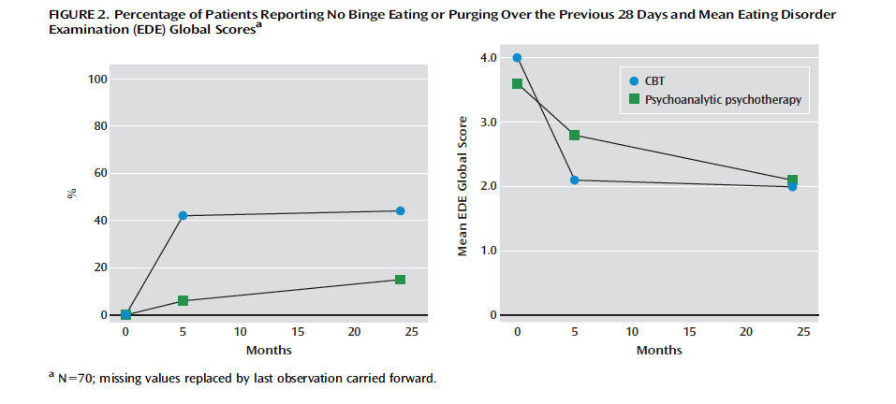
Treatment Research
Poulsen et al. (2014) compared 20 sessions of CBT-E (n = 36) to 2 years of weekly Psychoanalytic Psychotherapy (n = 34) for BN patients
Poulsen S. Lunn, S., Daniel, S. I. F., Folke, S., Mathiesen, B. B., Katznelson, H. … Fairburn, C. G. (2014). A randomized controlled trial of psychoanalytic psychotherapy or cognitive-behavioral therapy for bulimia nervosa. American Journal of Psychiatry, 171(1), 109-116.
Notes:
CBT – E has twice a week sessions for the first 4 weeks, then weekly for 10 weeks, then every other week for the last 6 weeks.
Both treatments led to improvement in symptoms, but after 5 months (the end of CBT-E) 42% of patients in CBT group and 6% of patients in the psychoanalytic psychotherapy group had stopped binge-eating and purging. At the 2 year follow up point (the end of psychoanalytic therapy), 44% of CBT and 15% of psychoanalytic group had stopped binge eating and purging.
This was especially notable because the clinic that conducted the study was psychoanalytically oriented, so they likely were better at delivering that form of therapy and had better expectations for it than they may have had for CBT.

Slide 41
What kind of treatment is provided in most Residential and Outpatient ED centers?
Notes:
Is it empirically supported?
Where were the clinicians trained?
Who is staffing the facility and what is their level of training?
What kinds of Tx are they doing?
Are they doing completely useless stuff that doesn’t have empirical support (Equine therapy, art/music/dance therapy, other touchy feely stuff)?
What are weight protocols for refeeding?
Are they collecting data to show patients are improving?

Slide 42
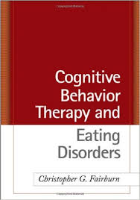
Are most clinicians delivering ESTs?
Psychologists who treat EDs
Tobin et al. (2007) Surveyed types of activities therapists use with ED patients
Sample: 265 Clinicians recruited at ED conferences and AED website
Results:
Use of Treatment Manuals: LIMITED
Only 6% adhered closely to treatment manuals
73% said they were flexible in how they applied a treatment manual
21% reported they had never studied a treatment manual
Tobin, Banker, Weisberg, & Bowers (2007). I know what you did last summer (and it was not CBT): A factor analytic model of international psychotherapeutic practice in the eating disorders. International Journal of Eating Disorders, 40, 754-757.
Notes:
Surveyed types of activities therapists use with ED patients
265 Clinicians recruited at ED conferences and AED website; Clinicians were primarily form North America (214), with 192 of those from the US; 26 from Australia, the remainder were from Europy & South America; Average of 11 years of practice with EDs; 16 hours/week treating those with ED; 57% were members of AED

Slide 43
Are most clinicians delivering ESTs?
Psychologists who treat EDs
Results:
Attitudes toward Treatment Manuals
8% felt manuals were important to follow because they were based on empirical studies
67% reported manuals contained important interventions, but they modified the techniques to fit their clinical practice
15% reported manuals had limited applicability in their actual clinical practice
Theoretical Approach
Only 13% used one theoretical approach
(95% > 1 approach used with same patient)
61% cognitive behavioral therapists
27% psychodynamic therapists
5% behavior therapists
2% family therapists
2% interpersonal therapists
Tobin, Banker, Weisberg, & Bowers (2007). I know what you did last summer (and it was not CBT): A factor analytic model of international psychotherapeutic practice in the eating disorders. International Journal of Eating Disorders, 40, 754-757.
Notes:
Attitudes towards treatment manuals correspond relatively well with clinicians actual use of treatment manuals
Theoretical approach
Authors describe this as a glass half full and half empty. Half full because most acknowledge importance of Tx techniques in the manuals, but half empty in that they are not following treatment recommendations as closely as they should be. It seems akin to a doctor prescribing that the patient only takes his or her antibiotics until s/he starts feeling better or just when s/he feels like it. Or a doctor prescribing different dosages for different patients based on intuition.

Slide 44
Why are self-proclaimed “CBT clinicians” not really doing CBT with their ED patients?
Anxious clinicians are less likely to deliver the more effective elements of CBT for eating disorders
Effective treatment techniques: Exposure to feared/avoided stimuli
Exposure to weekly weights
Food hierarchy
Breaking food- and exercise-related rituals
Clinician who does not push client to do these treatment elements may be engaging in his/her own “safety behavior” to reduce anxiety
Study sample: 113 clinicians who reported using CBT with at least part of ED clientele
Methods: 14 questions on degree of anxiety related to individual aspects of CBT-E treatment for EDs & the 12-item Intolerance of Uncertainty Scale
Turner, H., Tatham, M., Lant, M., Mountford, V. A., & Waller, G. (2014). Clinicians’ concerns about delivering cogntive-behavioral therapy for eating disorders. Behavior Research and Therapy, 57, 38-42. doi:10.1016/j.brat.2014.04.003
Notes:
Study sample: 113 clinicians who reported using CBT with at least part of ED clientele; mean 11.8 yrs experience working with ED; Professions included clinical psychology, psychiatry, nursing, social work, & Occupational therapy; 70% reported using CBT; Recruited from continuing education workshops on use of CBT for ED and NHS in the UK → Methods: 14 questions on degree of anxiety related to individual aspects of CBT-E treatment for EDs & the 12-item Intolerance of Uncertainty Scale

Slide 45
Why are self-proclaimed “CBT clinicians” not really doing CBT with their ED patients?
Results:
Greatest worry doing Body Image work and Ending Treatment
Least worry providing information (on food, eating, weight, health risks, etc.)
Factor analytically derived four main treatment areas: Cognitive aspects of treatment, Exposure, Education, and Process
Clinicians who were less tolerant of anxiety were more likely to worry about cognitive- and exposure-based treatment factors
Greater age and experience were associated with less worry about treatment delivery
Turner, H., Tatham, M., Lant, M., Mountford, V. A., & Waller, G. (2014). Clinicians’ concerns about delivering cogntive-behavioral therapy for eating disorders. Behavior Research and Therapy, 57, 38-42. doi:10.1016/j.brat.2014.04.003
Notes:
Study sample: 113 clinicians who reported using CBT with at least part of ED clientele; mean 11.8 yrs experience working with ED; Professions included clinical psychology, psychiatry, nursing, social work, & Occupational therapy; 70% reported using CBT; Recruited from continuing education workshops on use of CBT for ED and NHS in the UK

Slide 46
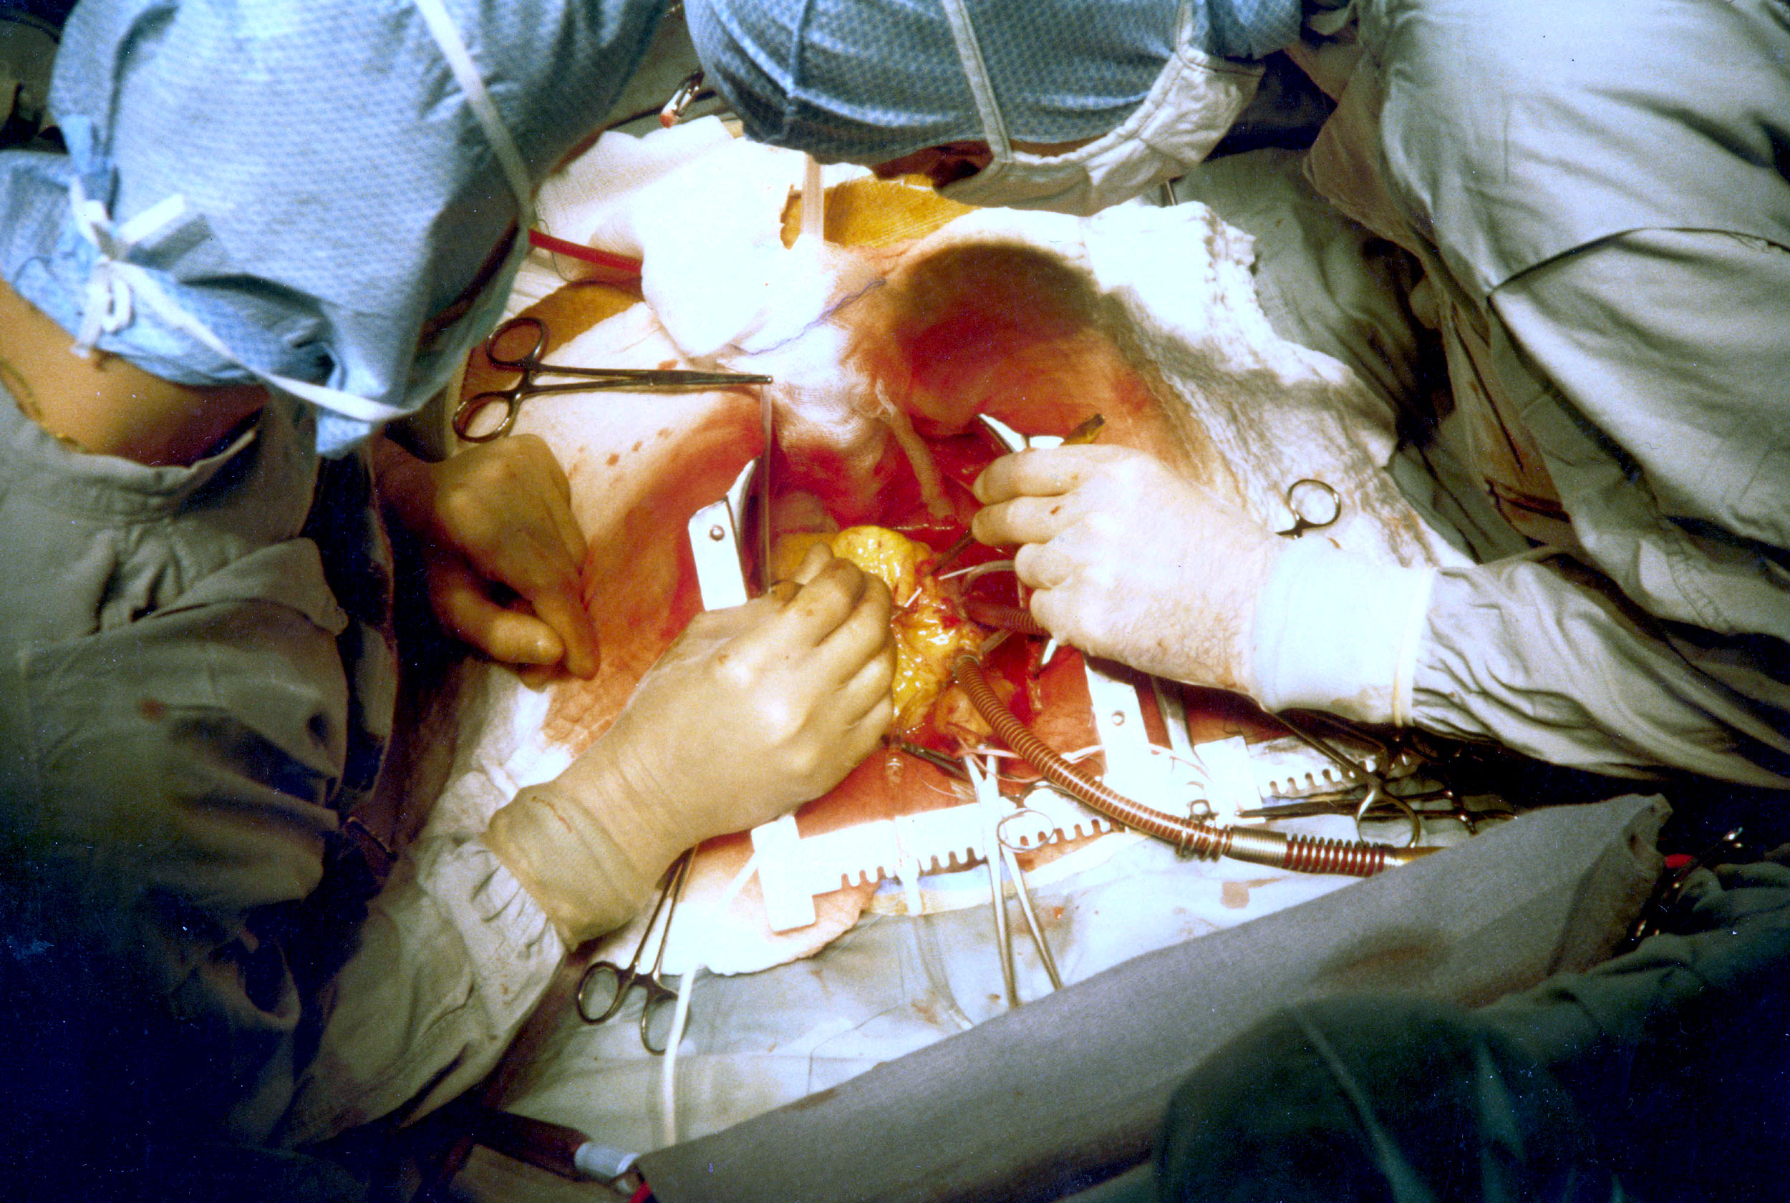
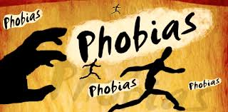
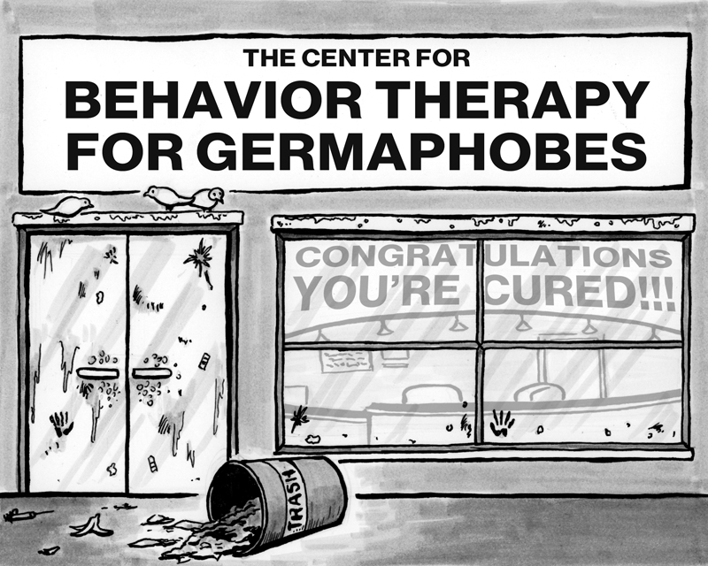
Is it ethical to expose patients to their greatest fears?
Is it ethical not to?
Notes:
With most anxiety-related conditions, cognitive-behavioral treatments (CBT) are empirically supported and are the treatment of choice (better than medications in the long-term for those of you medically inclined among us).
[click through images and describe phobias/Dxes where exposure is involved]
OCD, panic disorder, specific phobias, PTSD,.
All CBT manuals for these disorders involve exposure to feared stimuli.
Every term that I teach abnormal psychology, at least one students asks me, Professor Walker, How is this ethical? Especially those with a specific phobia (which is relatively common), I say, so the treatment called flooding to treat your fear of spiders might involve you going into a room with many spiders and just letting them crawl all over you for an hour or two or longer.
But A MORE IMPORTANT question is is it ethical NOT TO expose your patients to feared stimuli?
Yes, we’re causing emotional distress in the short term. So does surgery or traditional radiation and chemotherapy treatments for some cancers.
[Now that I’ve made myself hungry with pictures of cake & pizza, it seems like a good time for a break]

Slide 47
Discussion Overview
What are eating disorders?
Medical complications.
Multidisciplinary treatment
Training
Are we successfully training enough practitioners?
Treatment
Are treatment centers and practitioners providing the best available care?
Balancing Autonomy and Beneficence
Managed care
How does the health care industry impact treatment?

Slide 48
Discussion Overview
What are eating disorders?
Medical complications.
Multidisciplinary treatment
Training
Are we successfully training enough practitioners?
Treatment
Are treatment centers and practitioners providing the best available care?
Balancing Autonomy and Beneficence
Managed care
How does the health care industry impact treatment?

Slide 49
Discussion Overview
What are eating disorders?
Medical complications.
Multidisciplinary treatment
Training
Are we successfully training enough practitioners?
Treatment
Are treatment centers and practitioners providing the best available care?
Balancing Autonomy and Beneficence
Managed care
How does the health care industry impact treatment?
Notes:
Okay, so today we have talked about what eating disorders are, what the medical complications are, what treatment typically entails, and what best practices are.
We have discussed training shortcomings in the US and Canada.
We have discussed treatment pitfalls – not all centers use ESTs, even clinicians who say they use ESTs like CBT don’t! Clinicians who are anxious are especially likely not to.
We have discussed issues in challenges requiring care for those who do not want care.
We have discussed ways in which the managed care system in the US has interfered with patients receiving adequate care, which prolongs disorders and decreases chances for treatment success.
I have presented some qualitative research I have done with ED clinicians regarding the issues they come in contact with in practice.
We have looked at some scenarios with individuals with EDs where there are instances that the system in some way has failed the patients.
I hope that, despite my lack of bioethics training, I have provided you with a good snapshot of what the possible ethical issues in ED treatment, sparked your interest. With that being said →

Slide 50
Thank you
Questions?
Notes:
Thank you so much for your time and your attention.
Do you have any questions?

