Slide 1

Global Palliative Care
Joseph Lowy, MD
Clinical Professor of Medicine
Director, Palliative Care Services
Chair, Ethics Committee
NYU Langone Health
July 23, 2018

Slide 2
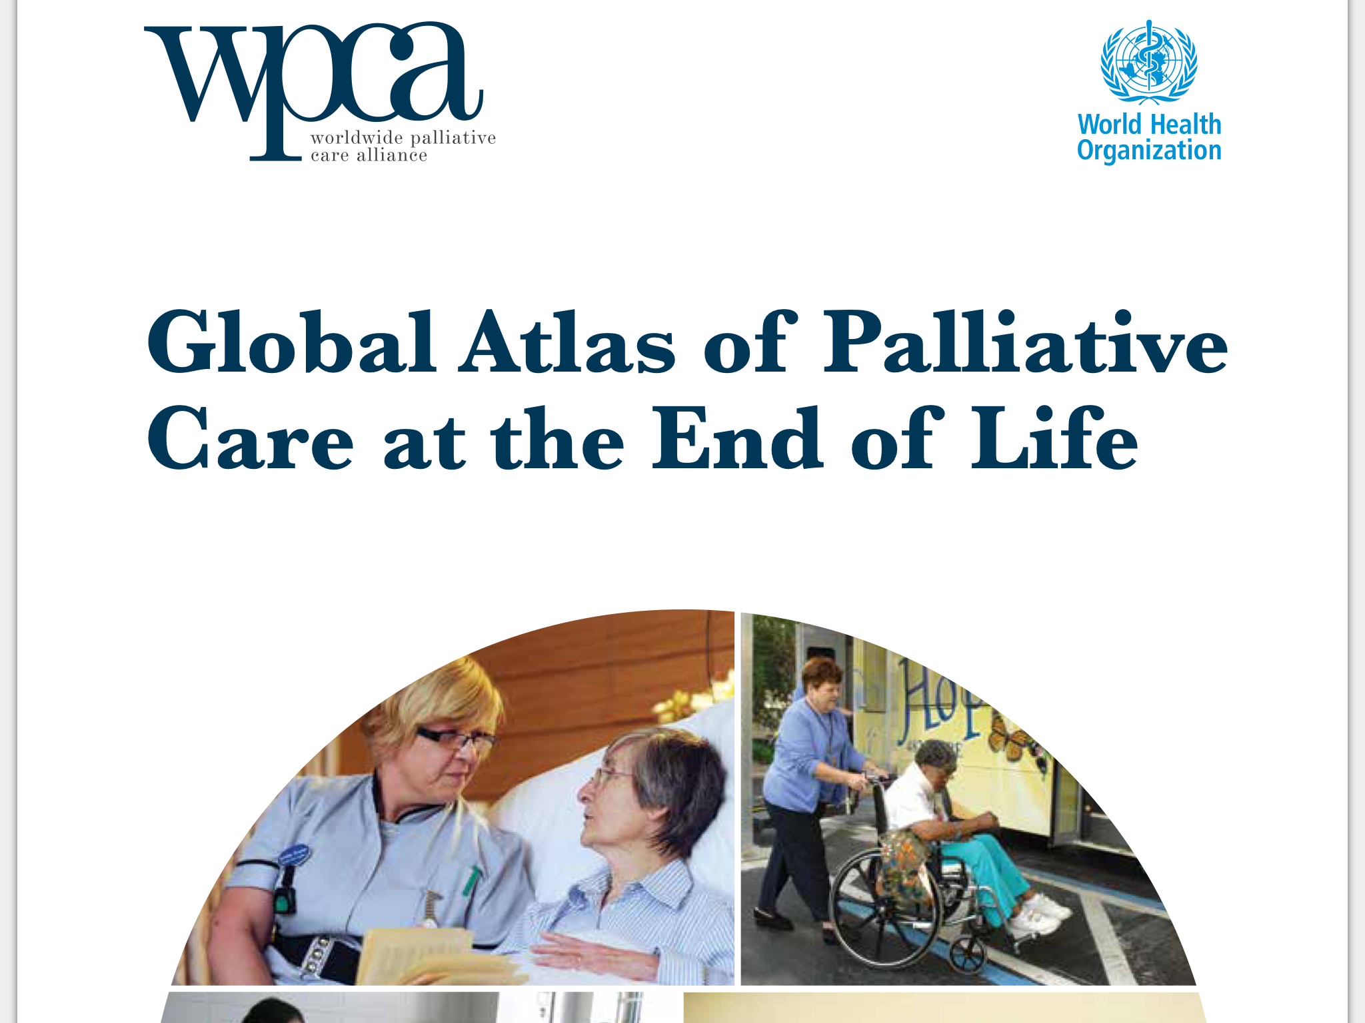

Slide 3
Purpose
What is palliative care?
Why is palliative care a human rights issue?
What are the main diseases requiring palliative care?
What is the need for palliative care?
What are the barriers to palliative care?
Where is palliative care currently available?
What are the models of palliative care worldwide?
What resources are devoted to palliative care?
What is the way forward?

Slide 4
What is Palliative Care
provides relief from pain and other distressing symptoms;
affirms life and regards dying as a normal process;
intends neither to hasten or postpone death;
integrates the psychological and spiritual aspects of patient care;
offers a support system to help patient’s live as actively as possible until death;
offers a support system to help the family cope during the patients illness and in their own bereavement;

Slide 5
What is Palliative Care
uses a team approach to address the needs of patients and their families, including bereavement counseling, if indicated;
will enhance quality of life, and may also positively influence the course of illness;
is applicable early in the course of illness, in conjunction with other therapies that are intended to prolong life, such as chemotherapy or radiation therapy, and includes those investigations needed to better understand and manage distressing clinical complications.

Slide 6
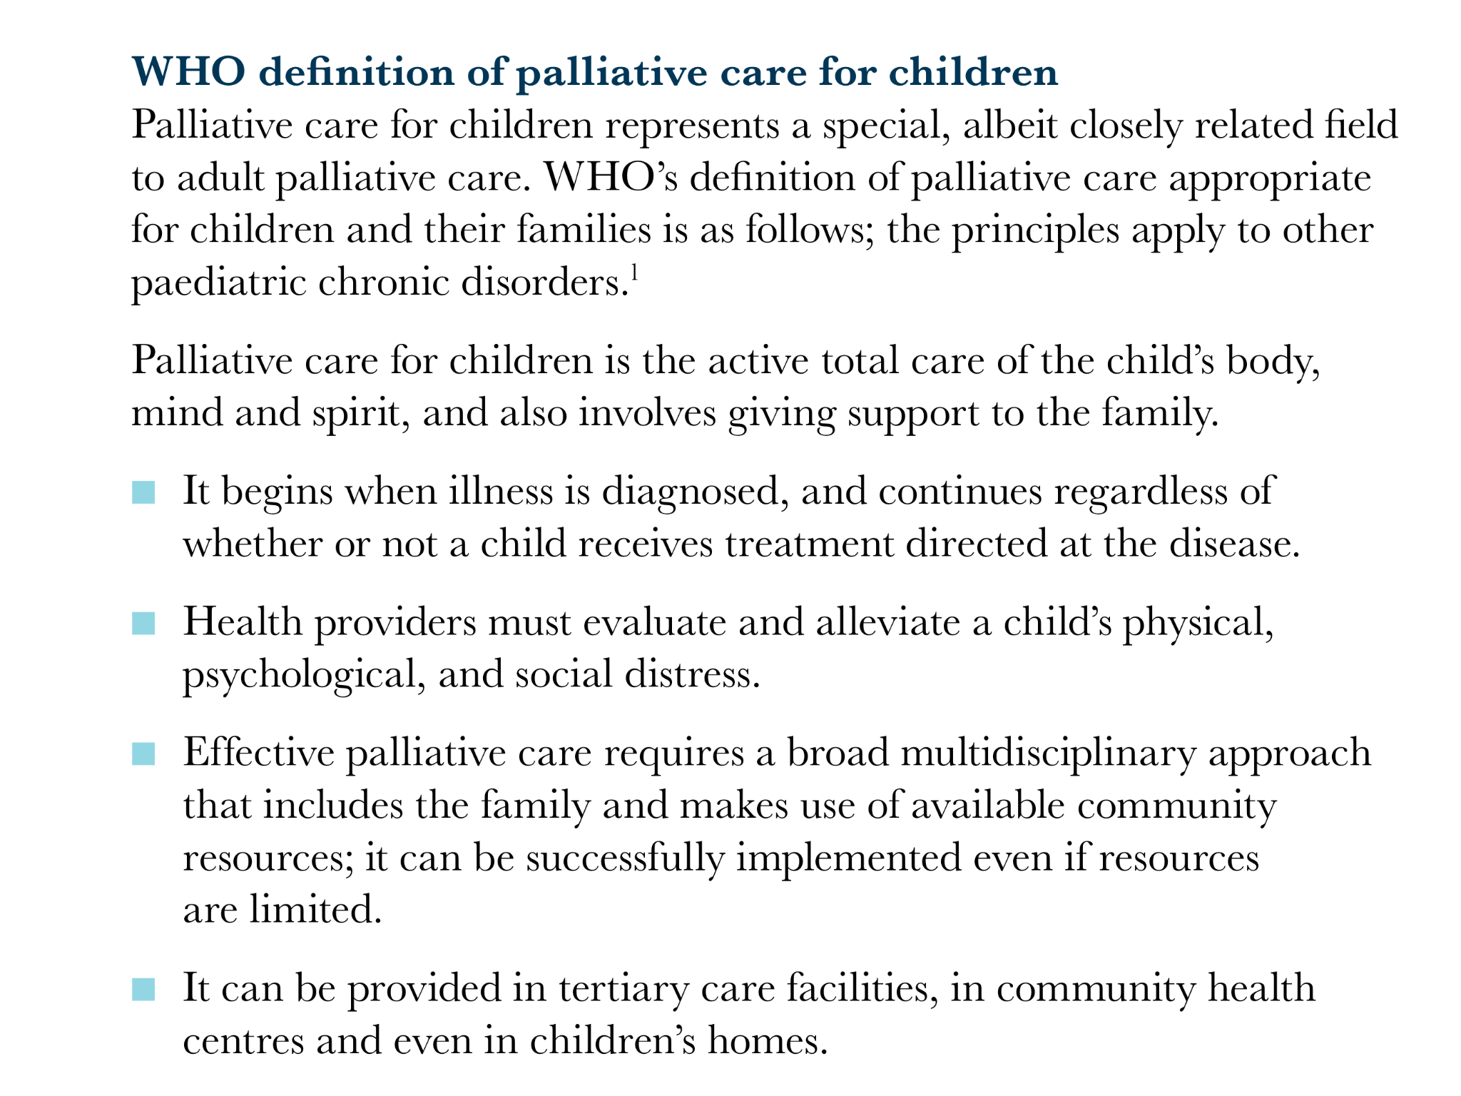

Slide 7
Palliative Care is a Human Rights Issue
International Human Right to Health from the International Covenant on Economic, Social and Cultural Rights(1966) calls for the “right of everyone to the enjoy of the highest attainable standard of physical and mental health”.
In 2000, core obligations were outlined to include access to health facilities, goods and services on a non-discriminatory basis; the provision of essential medicines as defined by WHO; and the adoption and implementation of a public health strategy.
In context of PC: all people with life-limiting illness should have access to basic medications for symptom control and terminal care. PC should be part of national health care policy. 14 PC medications are on WHO Essential Drug List.

Slide 8
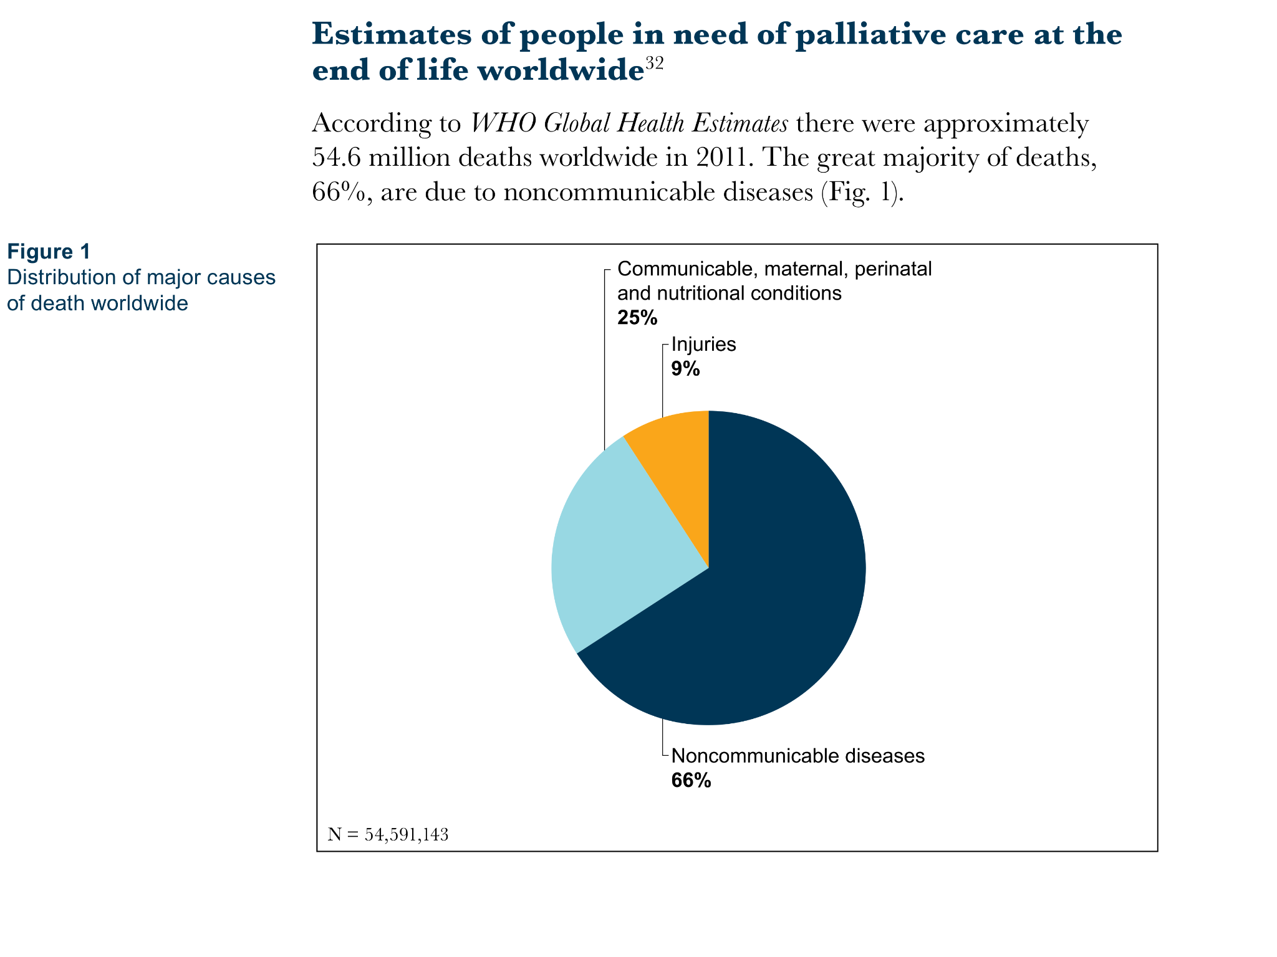

Slide 10
WHO Member States are grouped in 6 regions
AMRO-Region of the Americas
AFRO-African Region
EMRO-Eastern Mediterranean Region
EURO-European Region
SEARO-Southeast Asia Region
WPRO-Western Pacific Region

Slide 11
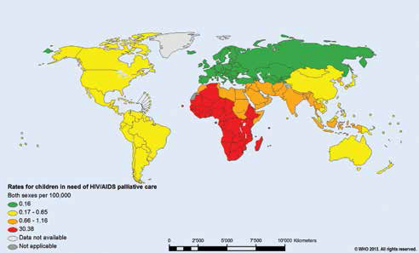
Notes:
Fig 3
World map showing the global distribution by WHO regions of rates for people in need of palliative care at end of life

Slide 12
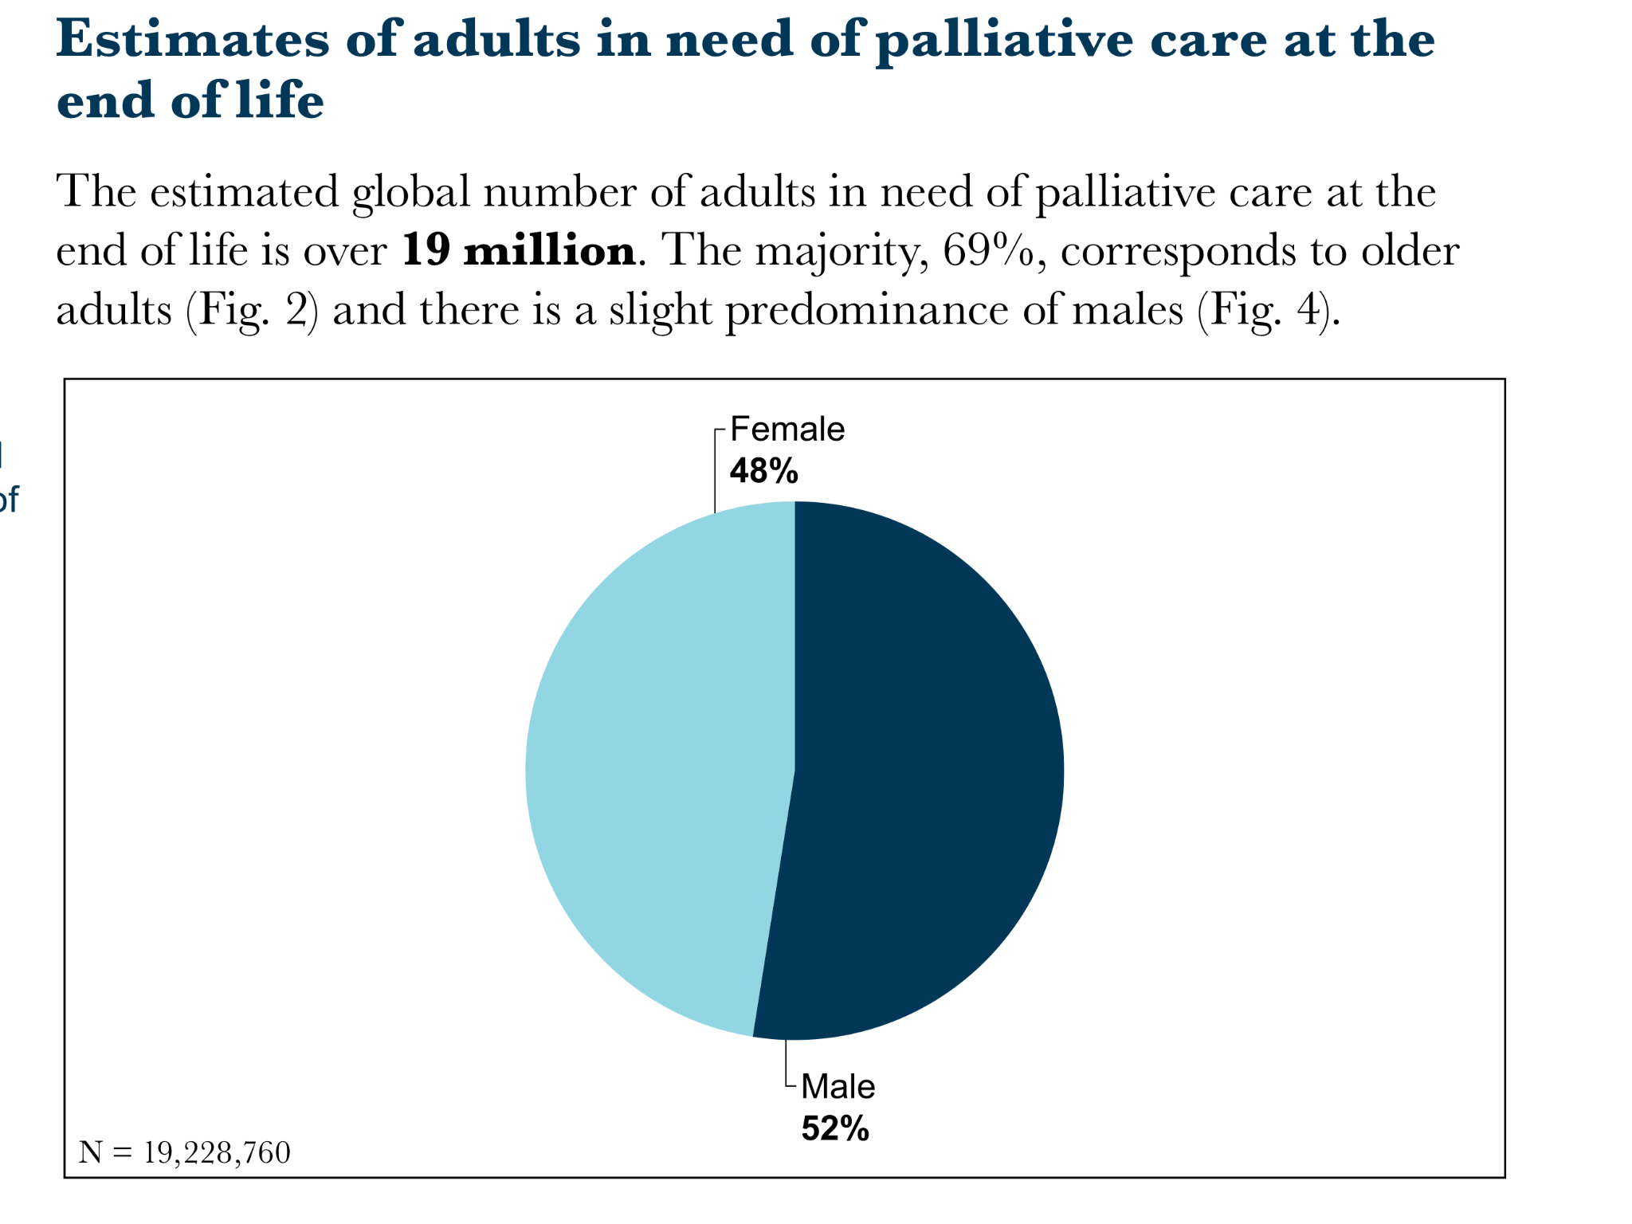

Slide 13
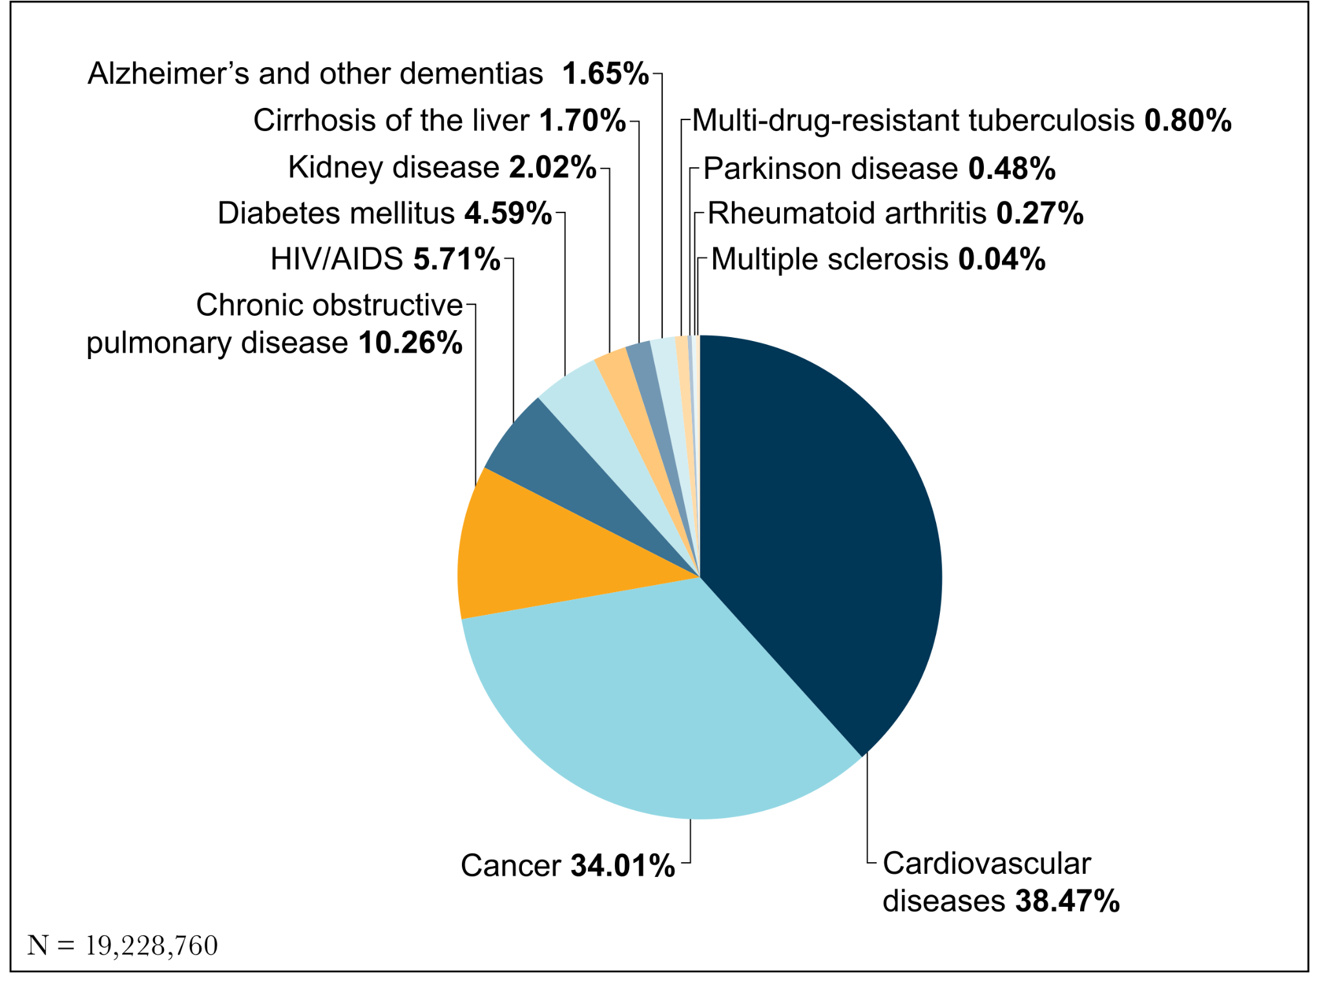

Slide 14
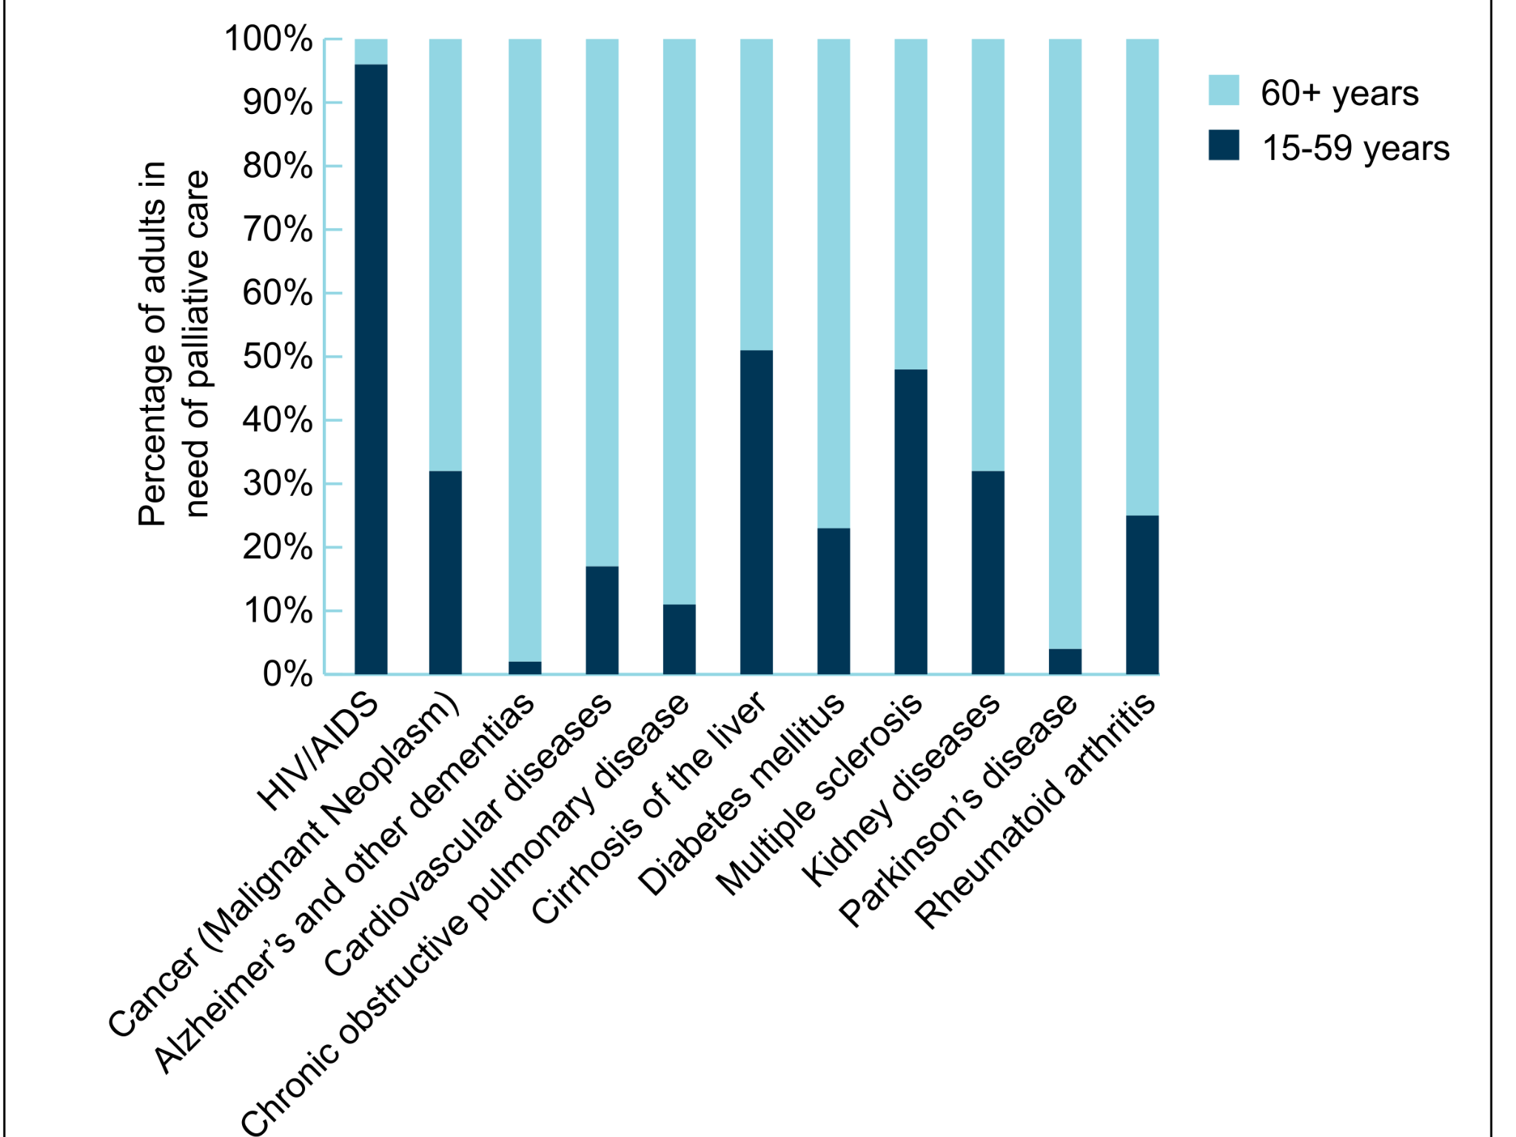

Slide 15
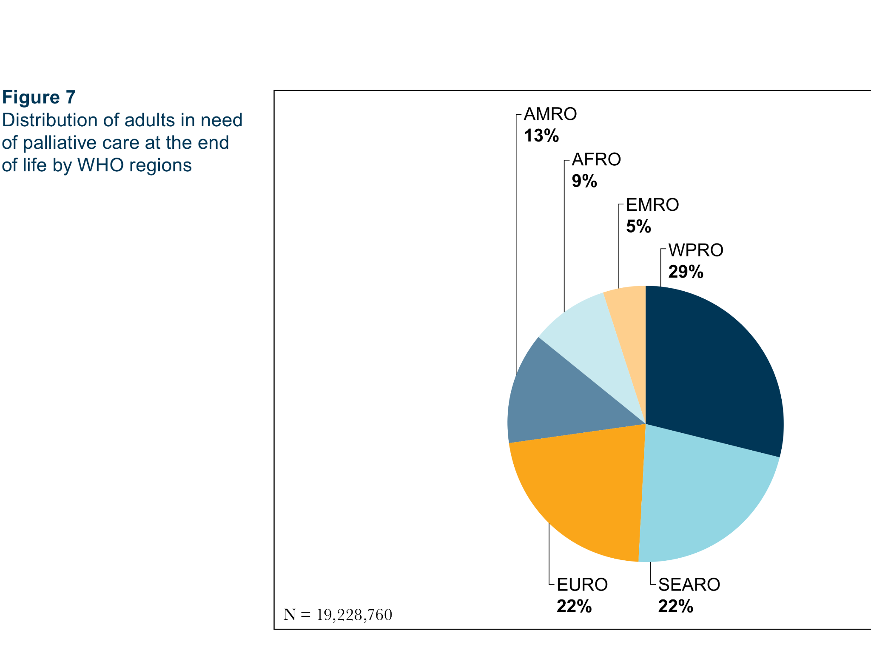
Notes:
Fig 7
Distribution of adults in need of palliative care at the end of life by WHO regions

Slide 16
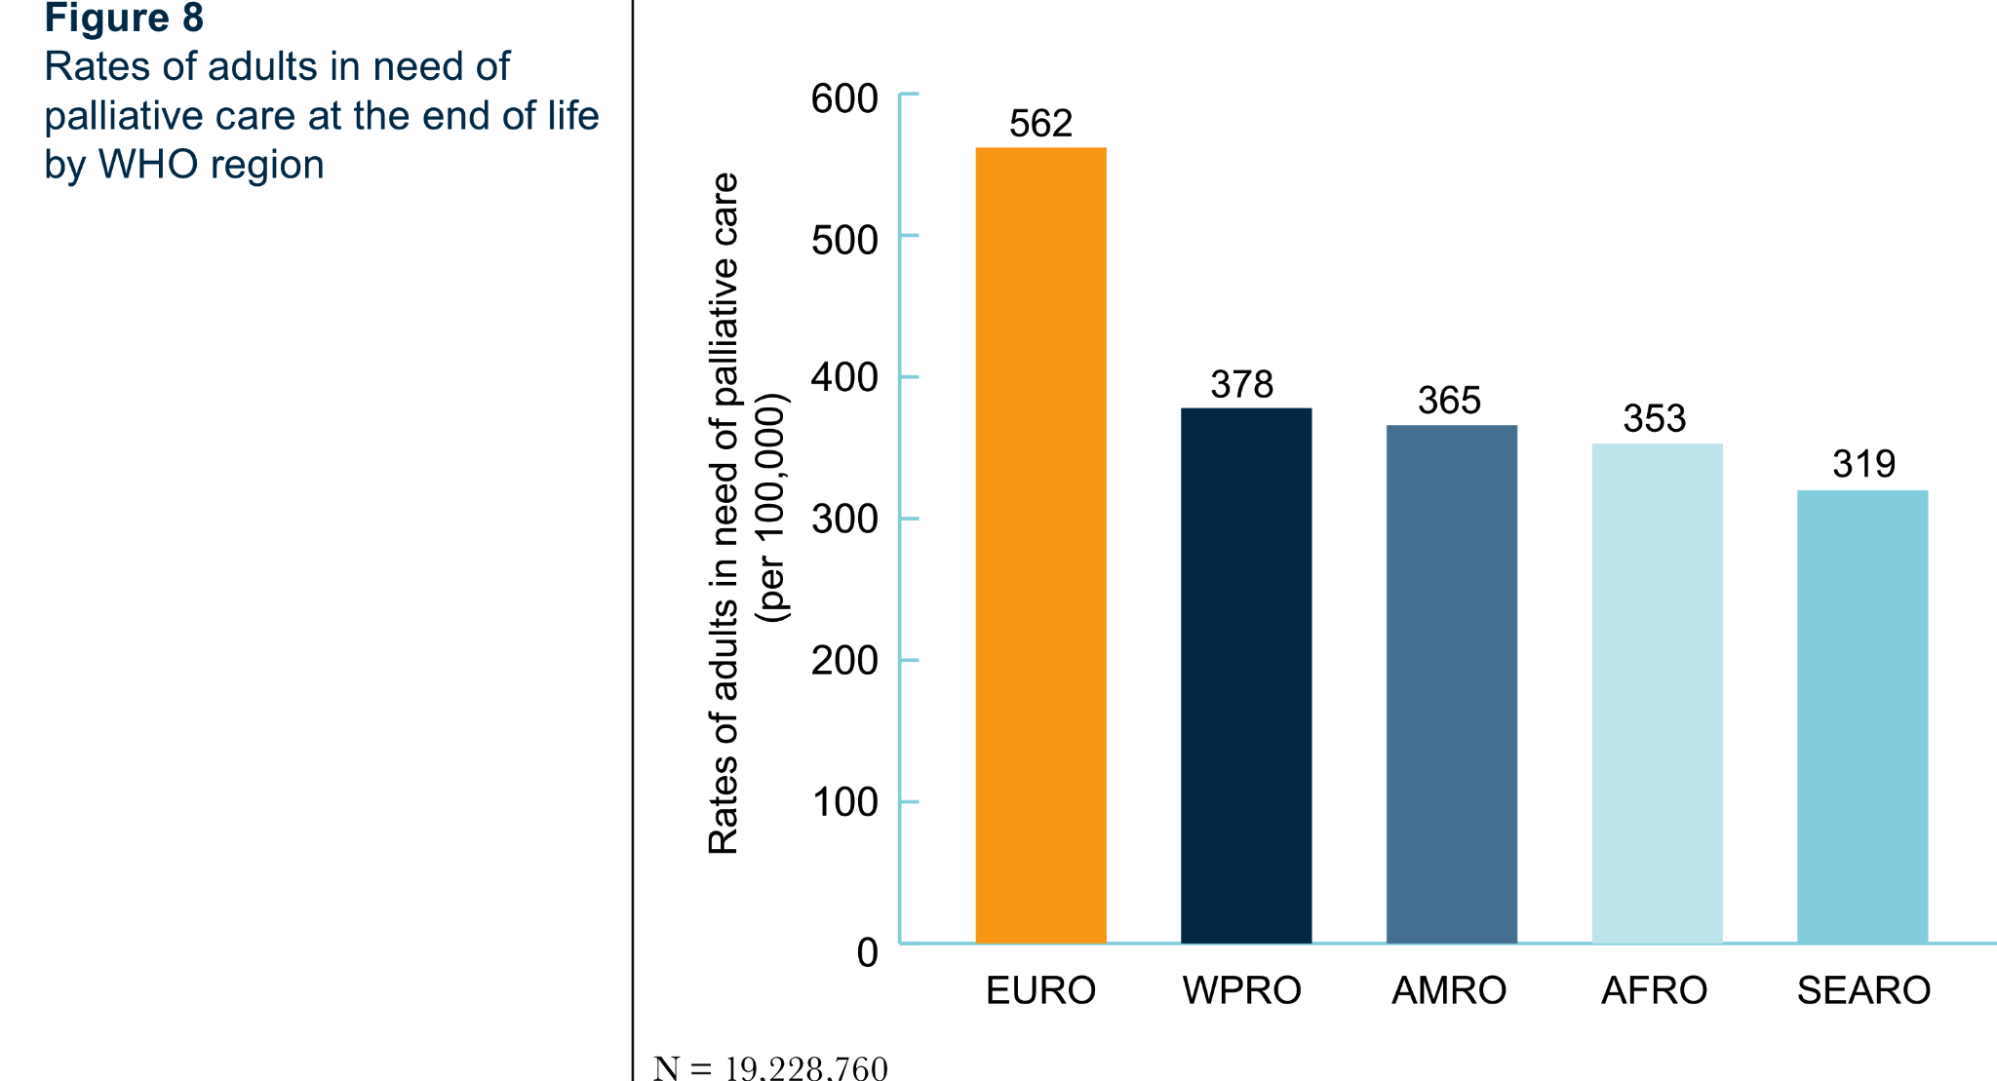
Notes:
Fig 8
Rates of adults in need of palliative care at the end of life by WHO region

Slide 17
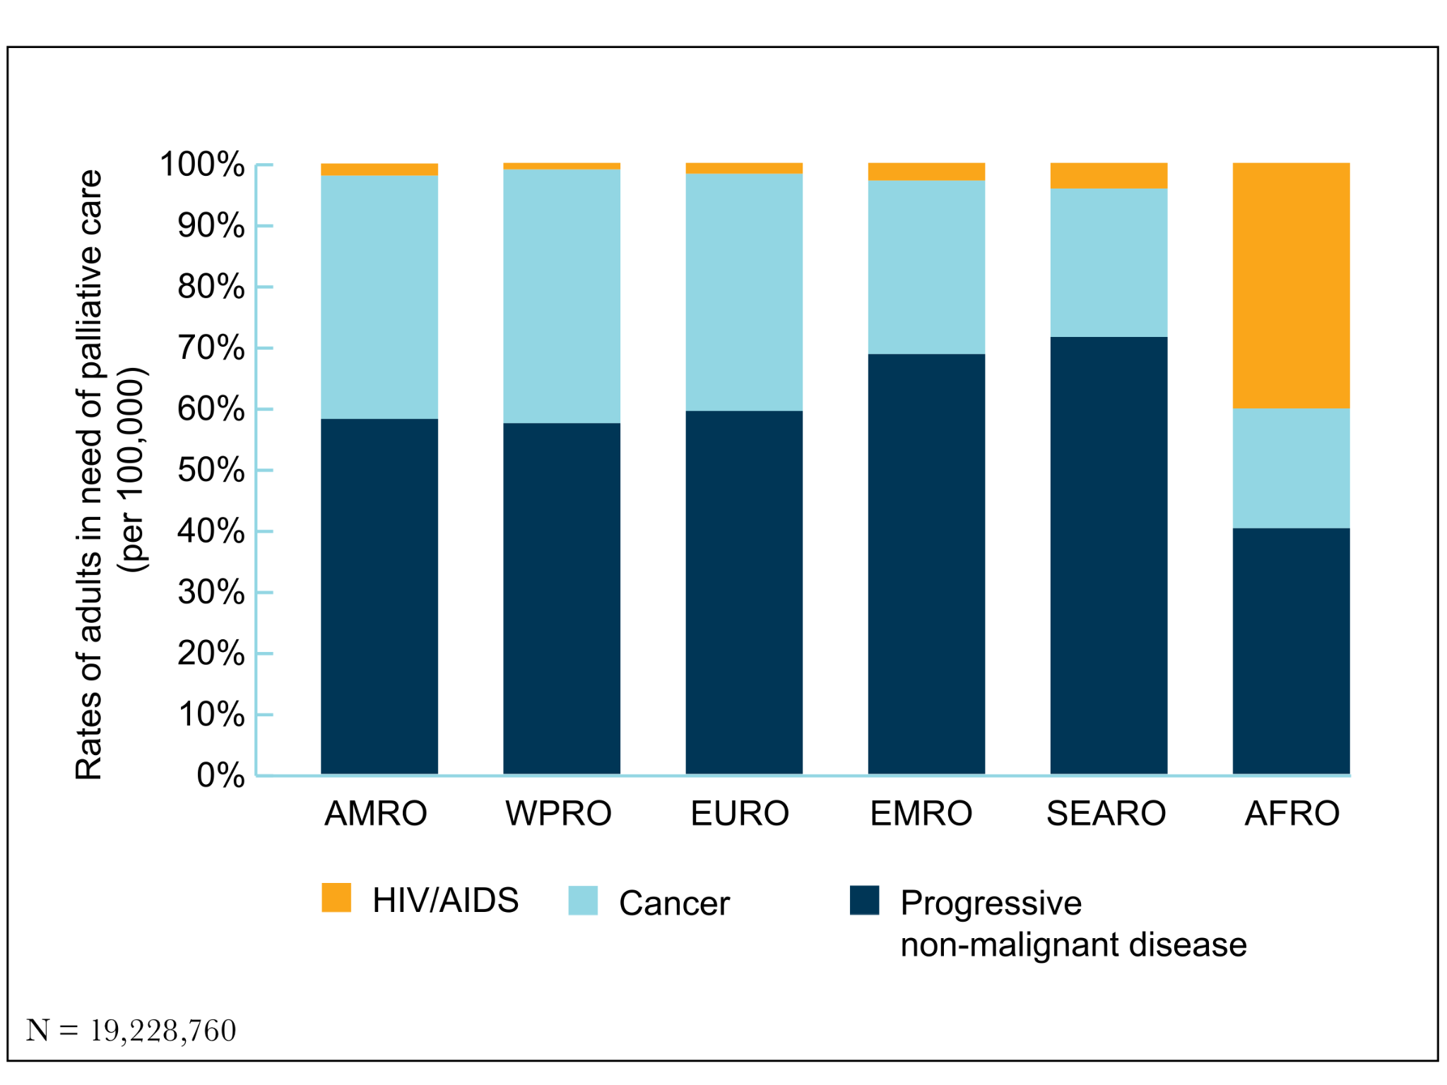
Notes:
Fig 9
Distribution of adults in need of palliative care at the end of life by WHO regions and disease categories

Slide 18
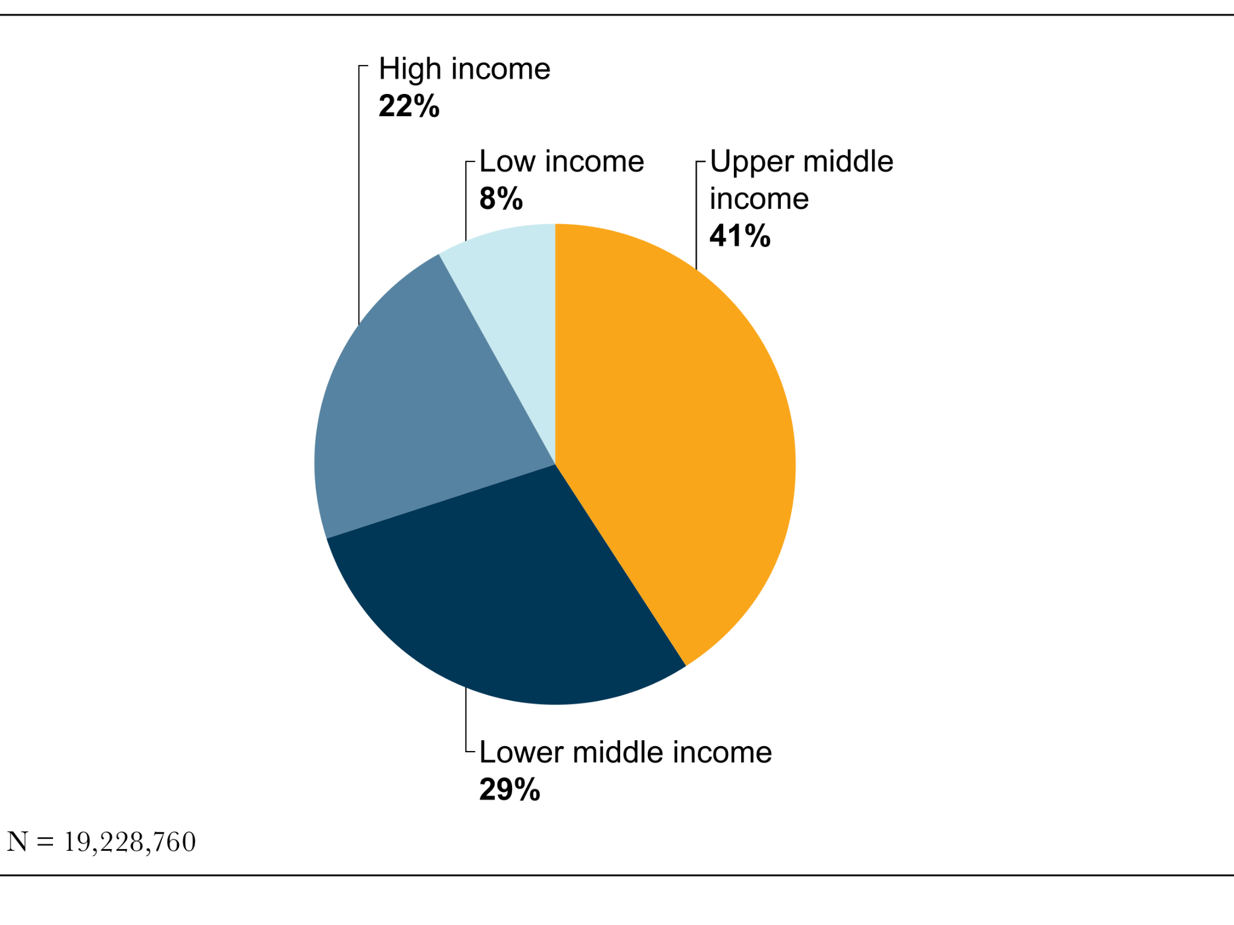
Notes:
Fig 10
Distribution of adults in need of palliative care at the end of life by World Bank country income groups

Slide 19
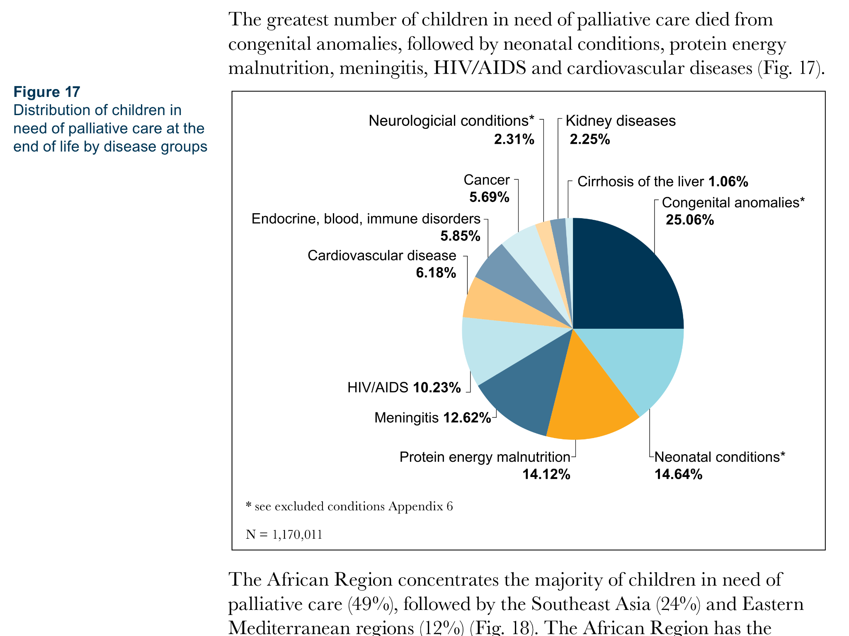
Notes:
Fig 17
Distribution of children in need of palliative care at the end of life by disease groups

Slide 20
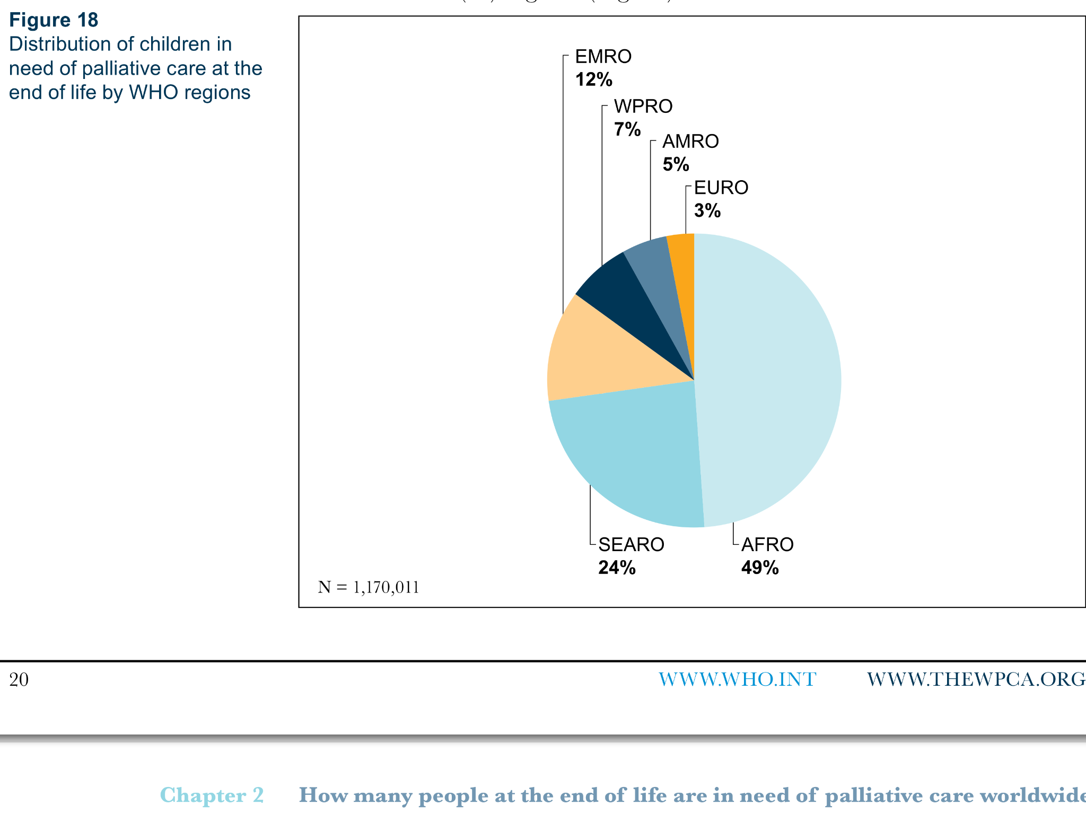
Notes:
Fig 18
Distribution of children in need of palliative care at the end of life by WHO regions

Slide 21
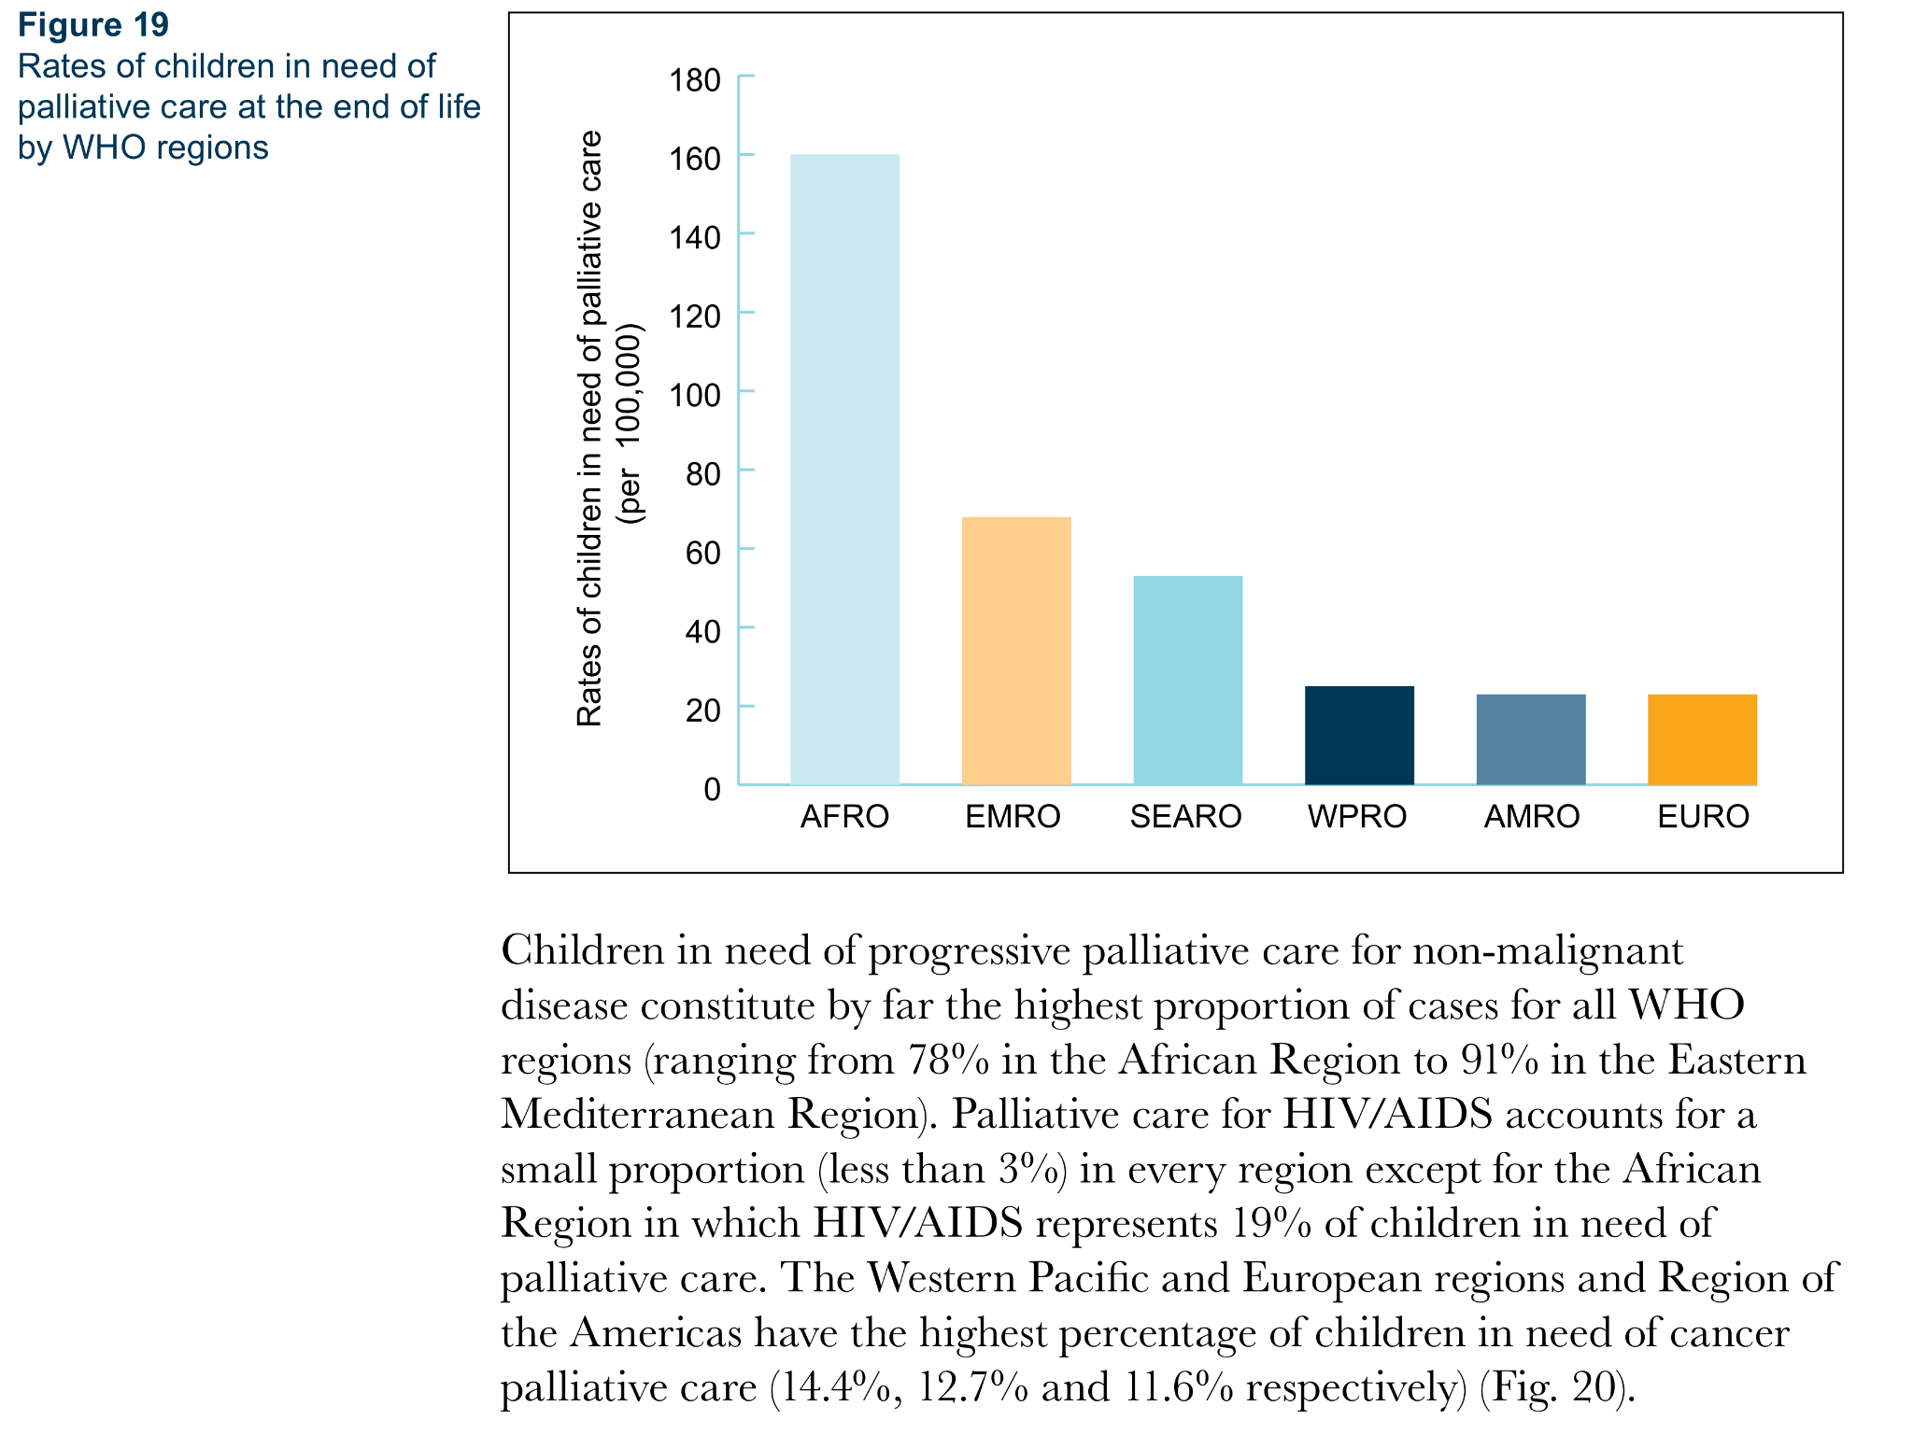
Notes:
Fig 19
Rates of children in need of palliative care at the end of life by WHO regions

Slide 22
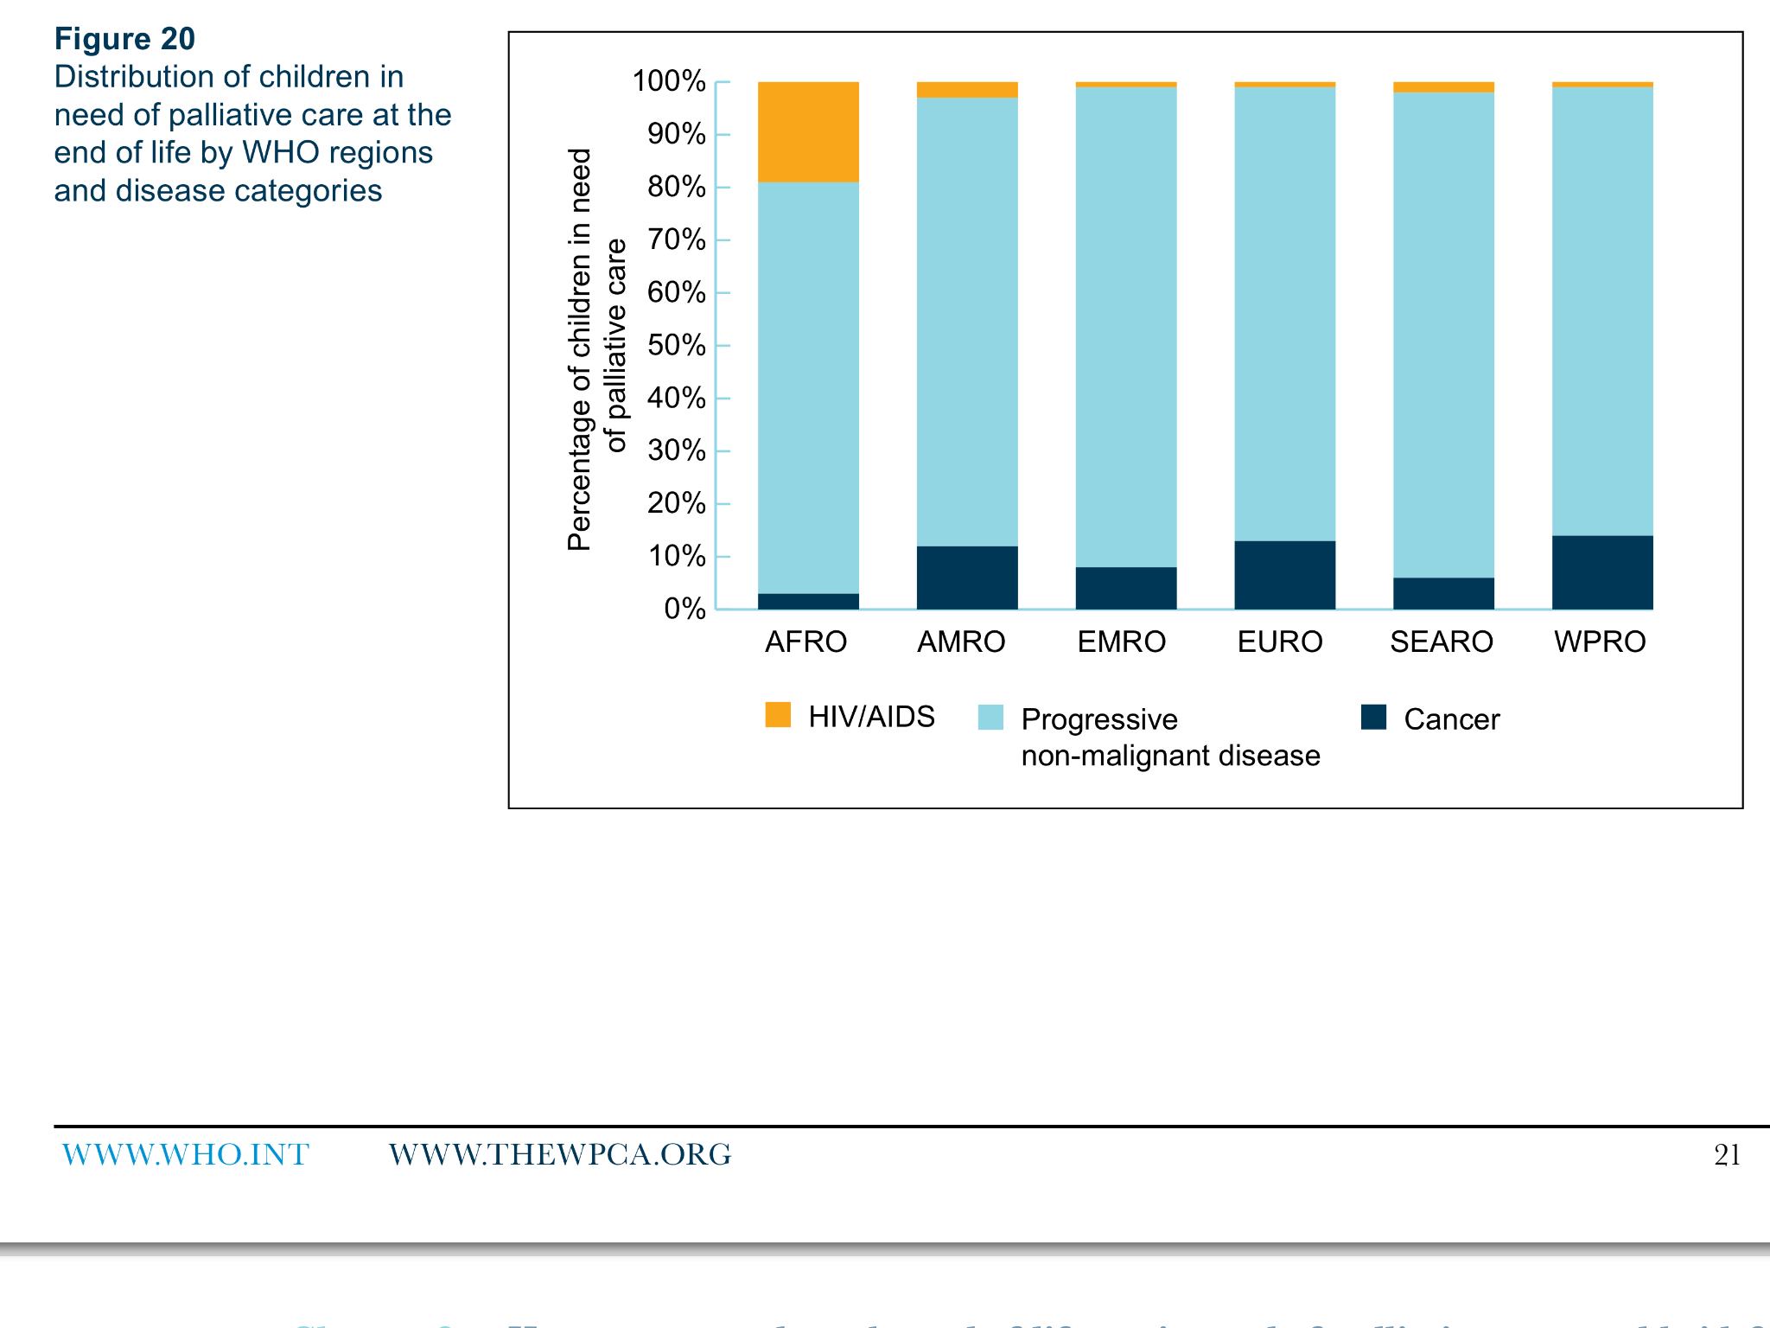
Notes:
Fig 20
Distribution of children in need of palliative care at the end of life by WHO regions and disease categories

Slide 23
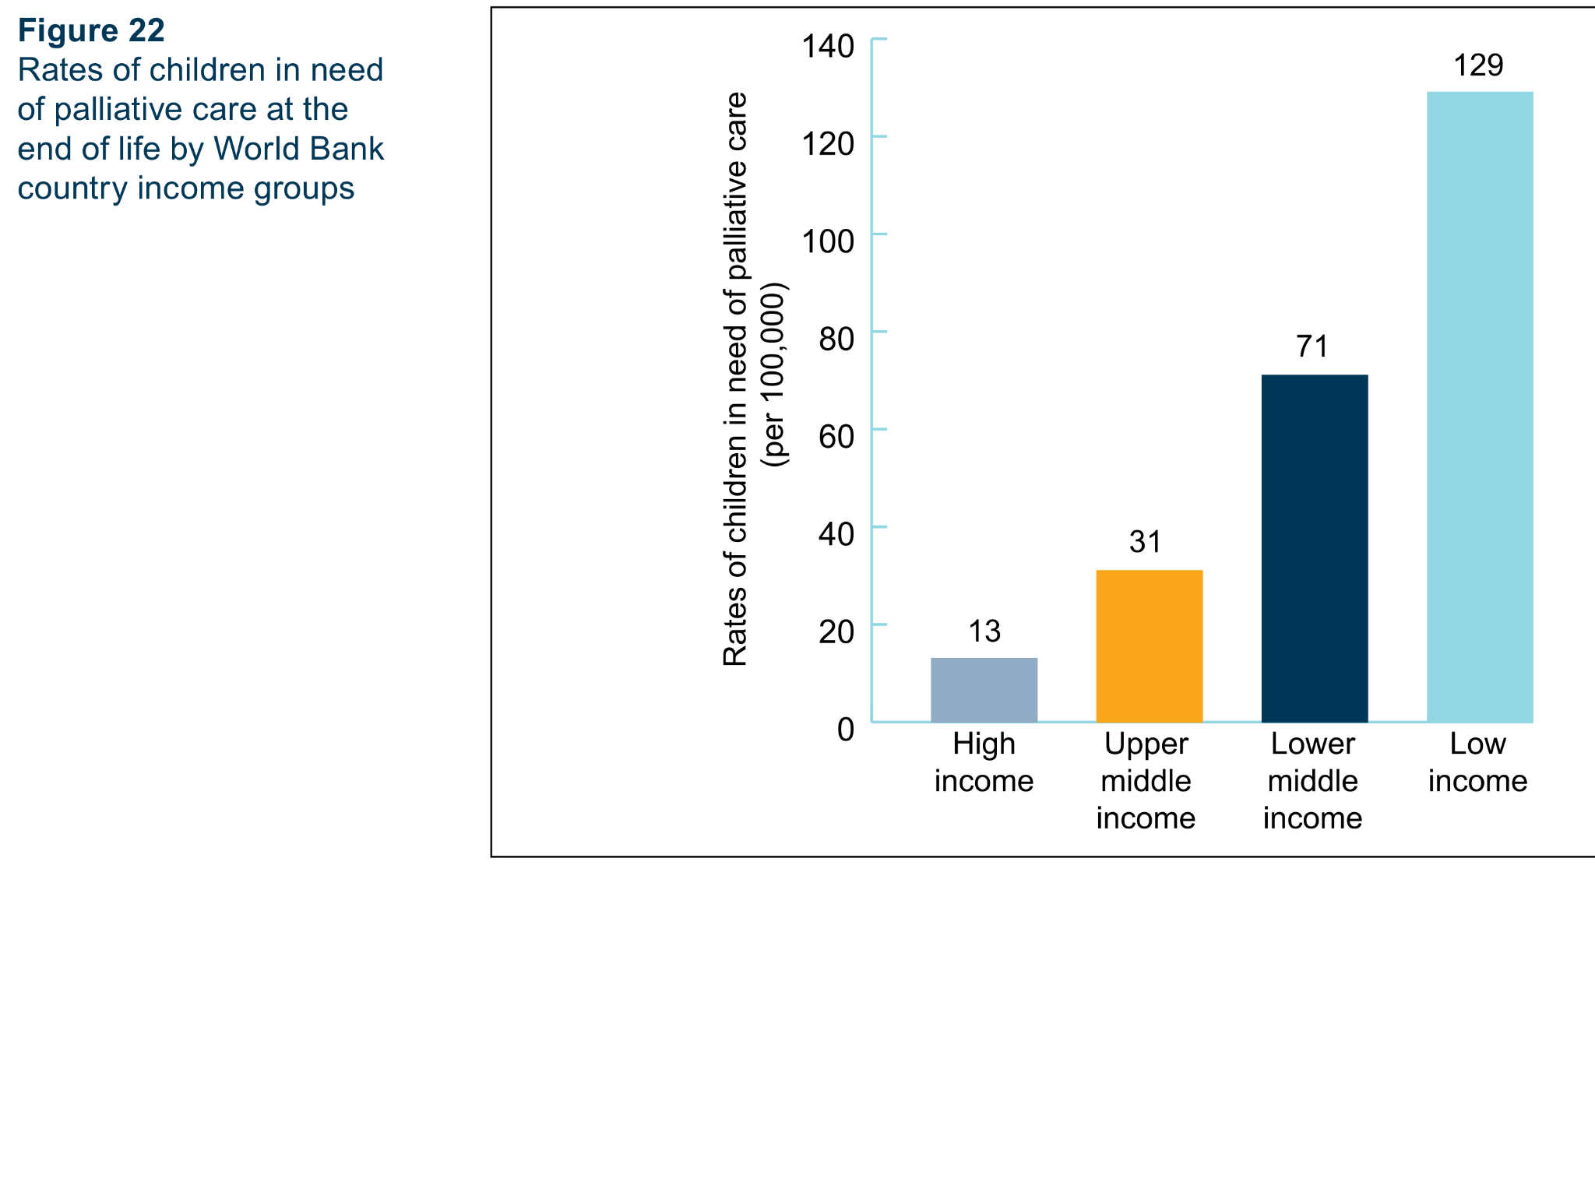
Notes:
Fig 22
Rates of children in need of palliative care at the end of life by World Bank country income groups

Slide 24
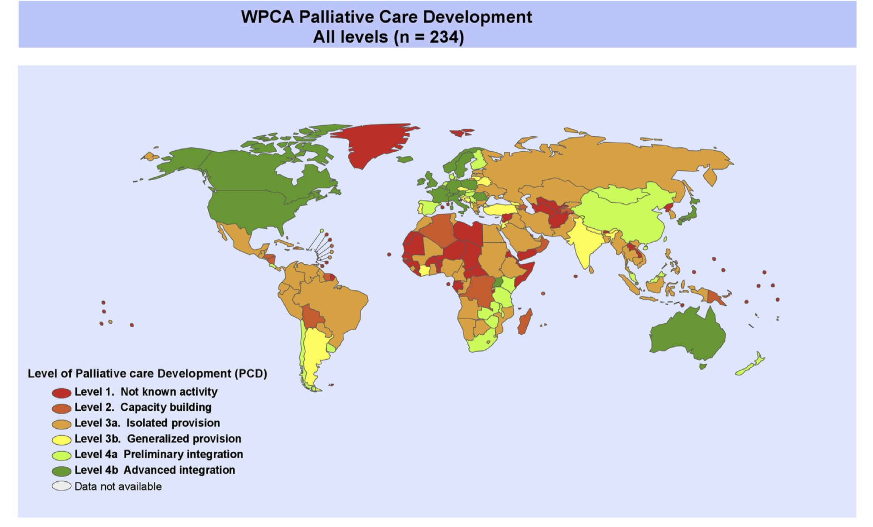

Slide 25
Summary
>20 million(37% total deaths) estimated to need PC annually
Majority are adults>60, 6% are children(1.2mill)
78% of adults and 98% of children in need of PC are low to mid income but highest rates are in high-income groups
Noncommunicable diseases represent 90% of burden of end of life(cancer and progressive nonmaligant: cardiovascular, COPD, diabetes…) except in Africa where HIV/AIDS contributes 42% of burden
The majority of the world has isolated provision of palliative care or worse

Slide 26
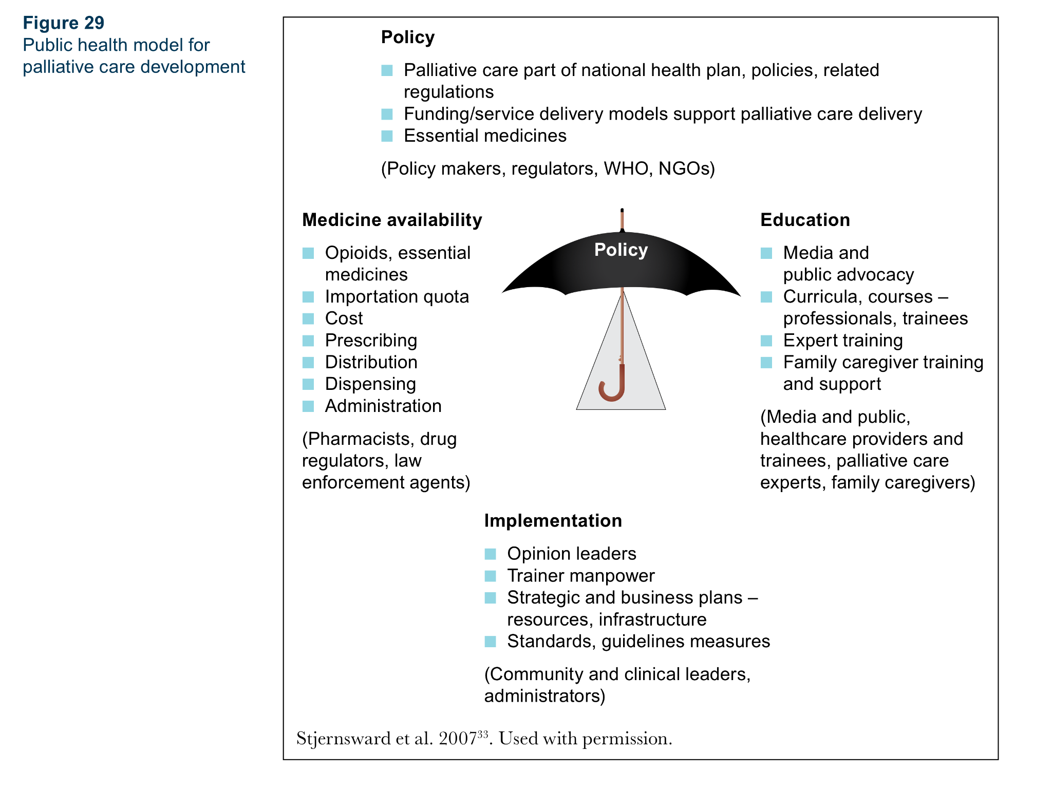
Notes:
Fig 29
Public health model for palliative care development

Slide 27


